Slide 1
Are there long term side effects caused by mRNA COVID-19 vaccines?
The medical and scientific community is confident in the long-term safety of the mRNA COVID-19 vaccines – the vaccine is not expected to have any long-term effects.
Researchers have been working with mRNA for decades in vaccines and cancer research, and decades of studying mRNA have shown no long-term side effects. In addition, the mRNA in the vaccine is broken down pretty
quickly in our cells.
Most side effects are mild and are caused by your immune system responding to the vaccine. These reactions usually don’t last for more than a few days.
Notes:
***mRNA COVID-19 vaccine trials started over a year ago, and millions of people have received the vaccines since with no long term side effects reported

Slide 2
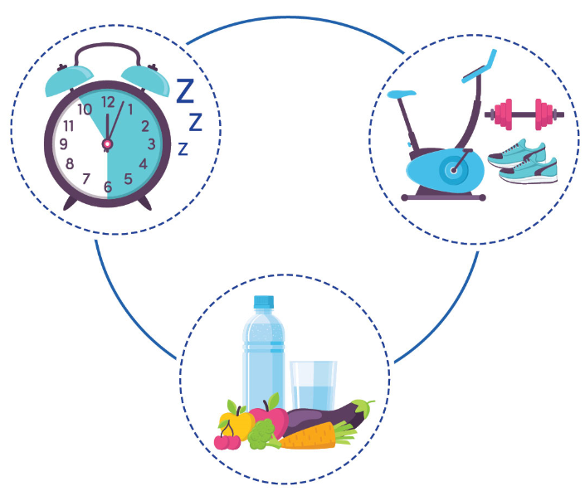
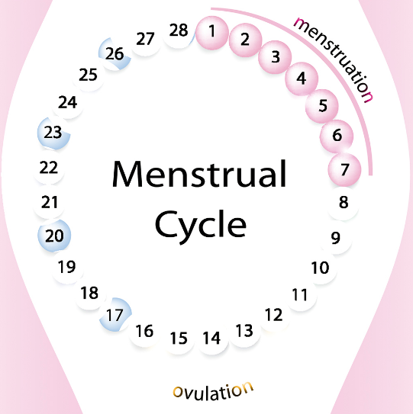
Can being near someone who received a covid-19 vaccine affect my menstrual cycle?
No. Your menstrual cycle cannot be affected by being near someone who received a COVID-19 vaccine. Many things can affect menstrual cycles, including stress, changes in your schedule, problems with sleep, and changes in diet or exercise. Infections, such as COVID-19, may also affect menstrual cycles.

Slide 3
Do any of the COVID-19 vaccines authorized for use in Canada shed or release any of their components?
No. Vaccine shedding is the term used to describe the release or discharge of any of the vaccine components in or outside of the body. Vaccine shedding can only occur when a vaccine contains a weakened version of the virus. None of the vaccines authorized for use in Canada contain a live virus.

Slide 4
I’ll take my chances with covid-19 instead of the vaccine
You are much more likely to get a serious complication from a COVID-19 infection than the vaccine.
COVID-19 infections that require hospitalization range from 18.9% to 31.4% with 13.8% to 20% being serious and 4.7% to 28% being critical.
Serious adverse events following immunization is 0.005%*.
*https://health-infobase.canada.ca/covid-19/vaccine-safety/summary.html

Slide 5
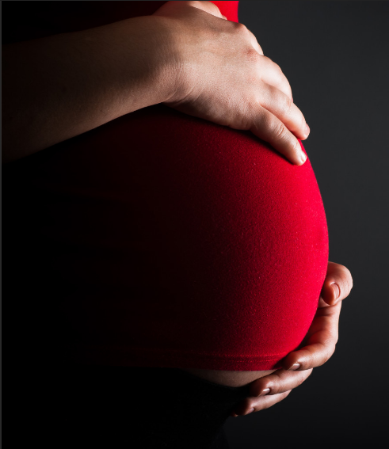
Is it safe for me to get a COVID-19 vaccine if I would like to have a baby one day?
Yes, if you are trying to become pregnant now or want to get pregnant in the future, you may get a COVID-19 vaccine when one is available to you.
There is no evidence that COVID-19 vaccination causes any problems with pregnancy, including the development of the placenta.
In addition, there is no evidence that fertility problems are a side effect of any vaccine, including COVID-19 vaccines.
Like all vaccines, scientists are studying COVID-19 vaccines carefully for side effects now and will continue to study them for many years.
It is encouraged to get the COVID-19 vaccine if you want to get
pregnant or are pregnant, as there is a greater chance that pregnant
people who get COVID-19 will require hospital care and possible
admission to the intensive care unit. Please see the COVID-19
Vaccination in Pregnancy & Breastfeeding Patient Decision-Making
Tool for more information.

Slide 6
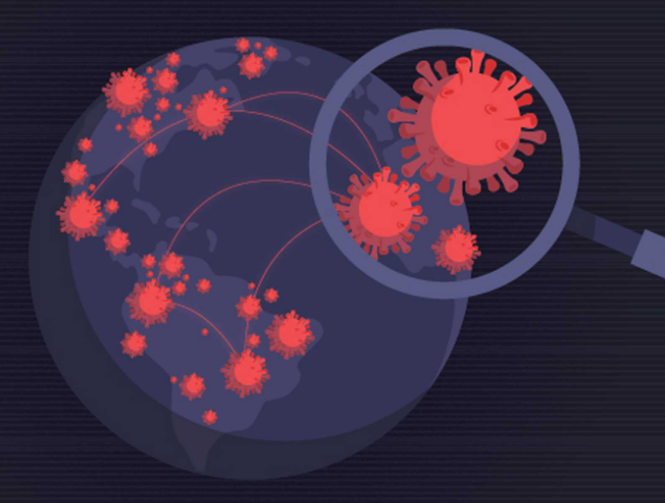
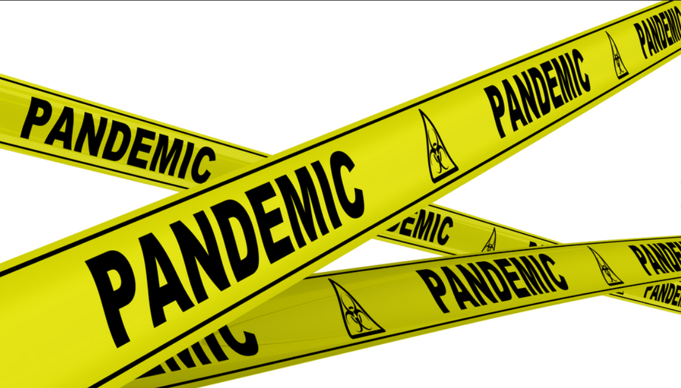
Since covid-19’s survival rate is so high, I don’t need a vaccine
It’s true that most people who get COVID-19 are able to recover.
But it’s also true that some people develop severe complications.
So far, more than 3.9 million people around the world have died from COVID-19 – and that does not account for people who survived but needed to be hospitalized.
Because the disease can damage the lungs, heart and brain, it may cause long-term health problems that experts are still working to understand.
There’s another reason to consider getting the vaccine: it protects those around you.
Even if COVID-19 does not make you very sick, you could pass it on to someone who might be more severely affected.
Widespread vaccination protects populations, including
those who are most at risk and cannot be vaccinated.
It will be important for ending the pandemic.

Slide 7
The vaccine is the reason why our case numbers are going up
The COVID-19 vaccine does not cause COVID-19.
The vaccines cannot give you COVID-19 because they don’t contain the virus that causes it.
No immunization is 100% protective. You can still get infected with COVID-19 after vaccination, but your risk is much lower.
Risk of contracting COVID-19 after two weeks decreases and continues to
decrease as immunization builds up.

Slide 8
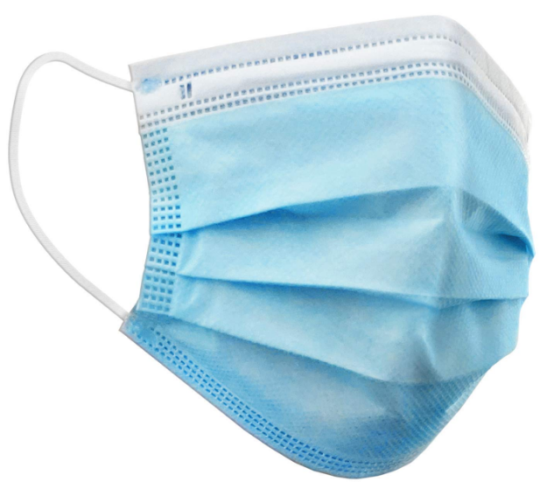
We still have to wear a mask so what’s the use of the vaccine?
The COVID-19 vaccines are the way out of this pandemic.
Data to date shows reduced spread of COVID-19 in populations, regions, or facilities with higher rates of vaccination or those that were vaccinated earlier than others.
The best protection is at least 2 weeks after the second dose.
As we continue to have individuals vaccinated, our community becomes more protected.
We’ll need to follow the public health measures until most people are protected by the vaccine.

Slide 9
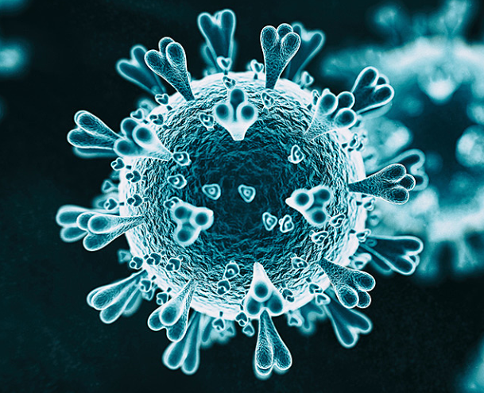
You can still get COVID-19 if you get the vaccine so why bother?
Vaccines work. You are much less likely to get infected with COVID-19 after being fully vaccinated, and if you do, you will likely experience milder symptoms and are less likely to be hospitalized.
Vaccination is one of the most effective ways to protect your health.
Vaccines work with the body’s natural defenses to develop protection against a disease.
One dose provides 60-80% protection from infection 3-4 weeks later.
A second dose provides over 80% protection.
Vaccines can help prevent severe disease and COVID-19 related hospitalization by 70-90%.
Risk of contracting COVID-19 is extremely low after two doses: 5.1%.

