Slide 1
COVID-19 for Community Members
APRIL 2020

Slide 2
COVID-19
On December 31, 2019, an outbreak of pneumonia associated with a new coronavirus (COVID-19) was reported in China.
The outbreak is thought to have begun at a market for live poultry, wild animals and seafood in Wuhan, China.
China has shut down the Wuhan market, as well as domestic and international transportation links from Wuhan and other affected cities in an attempt to contain the spread of the virus.
Since then, COVID-19 has spread to many other countries.

Slide 3
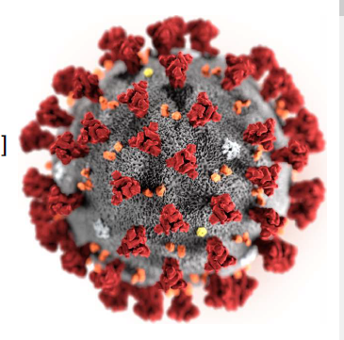
What is a Coronavirus?
Coronaviruses are a large family of viruses which may cause illness in animals or humans.
In humans, several coronaviruses are known to cause respiratory infections ranging from the common cold to more severe diseases such as Middle East Respiratory Syndrome (MERS) and Severe Acute Respiratory Syndrome (SARS).
The most recently discovered coronavirus causes coronavirus disease COVID-19.
Source: WHO (February 2020) Infection Prevention and Control for Novel Coronavirus (COVID-19)
Reference: World Health Organization (February 23, 2020). Q&A on coronaviruses (COVID-19). Retrieved from https://www.who.int/news-room/q-a-detail/q-a-coronaviruses

Slide 4
Is COVID-19 the same as SARS?
No
The virus that causes COVID-19 and the one that causes Severe Acute Respiratory Syndrome (SARS) are related to each other genetically, but they are different.
SARS is more deadly but much less infectious than COVID-19.
There have been no outbreaks of SARS anywhere in the world since 2003.
Reference: World Health Organization (February 23, 2020). Q&A on coronaviruses (COVID-19). Retrieved from https://www.who.int/news-room/q-a-detail/q-a-coronaviruses

Slide 5
Did the name change?
Yes
It was initially called novel Coronavirus nCoV-19.
The World Health Organization changed the name:
CO -“corona”, VI-“virus”, D-“disease” and the year it emerged 2019 = COVID-19
COVID-19 the official name for this disease.
Source: Centers for Disease Control (February 2020) Frequently Asked Questions and Answers; AHS (February 2020) Novel Corona virusn FAQ’s for the Public.

Slide 6
Current Situation: Global Pandemic
The World Health Organization officially declared COVID-19 as a global pandemic on March 11, 2020.
A pandemic is an outbreak of disease that occurs over a wide geographic area and affects an exceptionally high proportion of the population.

Slide 7
The numbers as of April XX, 2020 (WHO Situation Report – XX)
Globally – over 175 countries have reported cases of COVID-19
x,xxx,xxx cases
xx,xxx deaths
The WHO updates these numbers daily in the Situation Reports which can be found at the link below.
WHO (2020). Coronavirus disease (COVID-19) outbreak
https://www.who.int/emergencies/diseases/novel-coronavirus-2019

Slide 8
The numbers in Canada as of April XX, 2020
To date, xx,xxx cases have been announced in Canada.
There are x,xxx confirmed cases in Alberta.
Ongoing updates can be found on the Alberta Health website at https://www.alberta.ca/covid-19-alberta-data.aspx
Alberta Health (2020). COVID-19 coronavirus info for Albertans.

Slide 9
How does COVID-19 spread?
People can catch COVID-19 from others who have the virus.
The disease can spread from person to person through small droplets from the nose or mouth which are spread when a person with COVID-19 coughs or sneezes.
These droplets also land on objects and surfaces around the person. Other people then catch COVID-19 by touching these objects or surfaces, then touching their eyes, nose or mouth.
People can also catch COVID-19 if they breathe in droplets from a person with COVID-19 who coughs or sneezes.
This is why it is important to stay more than 2 meters (6 feet) away from a person who is sick.
Reference: World Health Organization (February 23, 2020). Q&A on coronaviruses (COVID-19). Retrieved from https://www.who.int/news-room/q-a-detail/q-a-coronaviruses

Slide 10
What are the symptoms of COVID-19?
The most common symptoms of COVID-19 are fever, dry cough, and difficulty breathing.
Some patients may have aches and pains, nasal congestion, runny nose, sore throat or diarrhea.
These symptoms are usually mild and begin gradually.
Some people become infected but don’t develop any symptoms and don't feel unwell.
Reference: World Health Organization (February 23, 2020). Q&A on coronaviruses (COVID-19). Retrieved from https://www.who.int/news-room/q-a-detail/q-a-coronaviruses

Slide 11
Who is most likely to get sick?
Anyone can get the disease, the risk depends on where you live or where you have travelled recently.
The risk of infection is higher in areas where a number of people have been diagnosed with COVID-19.
It is important to be aware of the situation in your area.
We are still learning about how COVID-2019 affects people, however, some groups appear to develop serious illness more often than others:
Older persons
People with pre-existing medical conditions, and those with
high blood pressure
heart disease
lung disease
Cancer
Diabetes.
Reference: World Health Organization (February 23, 2020). Q&A on coronaviruses (COVID-19). Retrieved from https://www.who.int/news-room/q-a-detail/q-a-coronaviruses

Slide 12
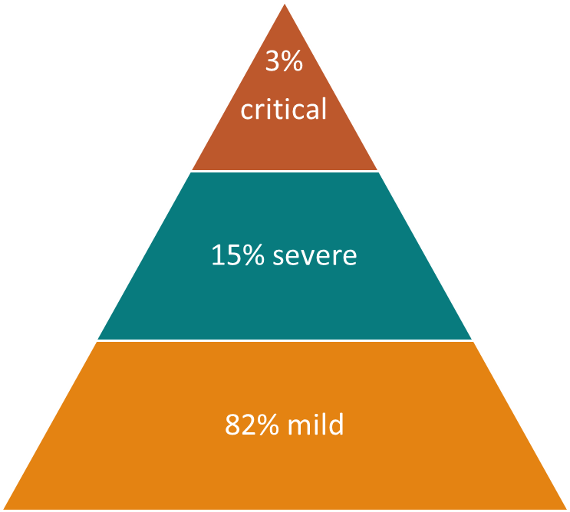
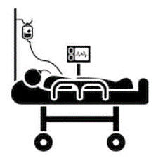
COVID-19 estimates on clinical severity
Source: World Health Organization (February 20 2020). EPI WIN Power point.

Slide 13
Should I worry about COVID-19?
Illness due to COVID-19 infection is generally mild, especially for children and young adults.
Most people (about 80%) recover from the disease without needing treatment.
However, it can cause serious illness: about 1 in every 5 people who catch it need hospital care. It is therefore quite normal for people to worry about how the COVID-19 outbreak will affect them and their loved ones.
Individuals over 60 years of age and those with pre-existing health conditions are most at risk of severe symptoms from COVID-19.
Reference: World Health Organization (February 23, 2020). Q&A on coronaviruses (COVID-19). Retrieved from https://www.who.int/news-room/q-a-detail/q-a-coronaviruses and Alberta Health - Info for Seniors https://www.alberta.ca/coronavirus-info-for-albertans.aspx#toc-2

Slide 14
Should I worry about COVID-19? (con’t)
We can channel our concerns into actions to protect ourselves, our loved ones and our communities.
First and foremost among these actions is regular and thorough hand-washing and good respiratory hygiene.
Secondly, keep informed and follow the advice of the local health authorities including any restrictions put in place on travel, movement and gatherings.
Reference: World Health Organization (February 23, 2020). Q&A on coronaviruses (COVID-19). Retrieved from https://www.who.int/news-room/q-a-detail/q-a-coronaviruses

Slide 15
Can I catch COVID-19 from the feces of someone with the disease?
The risk of catching COVID-19 from the feces of an infected person appears to be low.
While initial investigations suggest the virus may be present in feces in some cases, spread through this route is not a main feature of the outbreak.
Because this is a risk, however, it is another reason to clean hands regularly, after using the bathroom and before eating.
The World Health Organization is assessing ongoing research on the ways COVID-19 is spread and will continue to share new findings.
Reference: World Health Organization (February 23, 2020). Q&A on coronaviruses (COVID-19). Retrieved from https://www.who.int/news-room/q-a-detail/q-a-coronaviruses

Slide 16
Can humans become infected with COVID-19 from an animal source?
Coronaviruses are a large family of viruses that are common in animals.
Handle raw meat or animal organs with care to avoid contamination of uncooked foods and avoid consuming raw or undercooked animal products.
There is no evidence that companion animals or pets (such as cats and dogs) have been infected or could spread the virus that causes COVID-19.
Reference: World Health Organization (February 23, 2020). Q&A on coronaviruses (COVID-19). Retrieved from https://www.who.int/news-room/q-a-detail/q-a-coronaviruses

Slide 17
Is it safe to receive a package from any area where COVID-19 has been reported?
Yes
The likelihood of an infected person contaminating commercial goods is low and the risk of catching the virus that causes COVID-19 from a package that has been moved, travelled, and exposed to different conditions and temperature is also low.
Reference: World Health Organization (February 23, 2020). Q&A on coronaviruses (COVID-19). Retrieved from https://www.who.int/news-room/q-a-detail/q-a-coronaviruses

Slide 18
Can COVID-19 be caught from a person who has no symptoms?
The main way the disease spreads is through respiratory droplets expelled by someone who is coughing.
The risk of catching COVID-19 from someone with no symptoms at all is very low.
However, many people with COVID-19 experience only mild symptoms. This is particularly true at the early stages of the disease.
It is therefore possible to catch COVID-19 from someone who has, for example, just a mild cough and does not feel ill.
Reference: World Health Organization (February 23, 2020). Q&A on coronaviruses (COVID-19). Retrieved from https://www.who.int/news-room/q-a-detail/q-a-coronaviruses

Slide 19
How likely am I to catch COVID-19?
The risk depends on where you are - and more specifically, whether there is a COVID-19 outbreak unfolding there.
AHS/AH and FNIHB are carefully monitoring and taking the necessary steps to find cases and help prevent the ongoing spread of the virus.
Currently, aggressive measures are in place to help slow the spread of COVID-19 in Alberta.
References: World Health Organization (February 23, 2020). Q&A on coronaviruses (COVID-19). Retrieved from https://www.who.int/news-room/q-a-detail/q-a-coronaviruses; Alberta health Services (February 2020). Novel coronarvirus (COVID-19) FAQs for Public).

Slide 20
COVID-19 Public Health Orders
On March 25, Alberta’s Chief Medical Officer of Health issued orders under the Public Health Act to legally require:
- restrictions on gatherings and businesses
- returning international travellers to self-isolate for 14 days
- people exposed to COVID-19 to self-isolate for 14 days
- people with symptoms – cough, fever, shortness of breath, runny nose or sore throat not related to a pre-existing illness or health condition to self-isolate for 10 days, or until symptoms resolve, whichever is longer
- limited access to all nursing homes, designated supportive living and long-term care facilities, seniors lodges and residential addiction treatment facilities
Source: Alberta Health: COVID-19 info for Albertans https://www.alberta.ca/coronavirus-info-for-albertans.aspx

Slide 21
Public Health Restrictions on Gatherings
To help prevent the spread of COVID-19:
No gatherings with more than 15 attendees are allowed in one indoor or outdoor location.
- Examples of indoor and outdoor gatherings include: weddings, funerals, religious services, informal events, conferences, educational seminars and workshops, and group volunteering initiatives.
All individuals found to be in violation of gathering restrictions are subject to a $1,000 penalty.
Source: Alberta Health: COVID-19 info for Albertans https://www.alberta.ca/coronavirus-info-for-albertans.aspx#toc-2

Slide 22
Public Health Restrictions on Gatherings
People gathered in groups of fewer than 15 people must maintain a distance of 2 metres from one another.
Any gatherings with fewer than 15 people must not include activities that could promote disease transmission. This includes singing, as infected people can transmit the virus through their saliva or respiratory droplets while singing.
Other activities considered high risk include – but are not limited to – cheering, hand shaking, preparing food, sharing food or beverages, and buffet-style meals.

Slide 23
Public Health Restrictions on Businesses
Non-essential retail businesses, non-critical health care, and personal service facilities are prohibited from operating.
Essential services, such as grocery stores, airports, health care facilities, shopping centres, are exempt.
Albertans are prohibited from attending public recreation facilities and private entertainment facilities (i.e. public swimming pools, casinos, bingo halls, bars, and theatres).

Slide 24
Public Health Restrictions on Businesses
The following restrictions are in place for food facilities:
All dine-in services are prohibited.
Take-out, delivery and drive-thru services are still allowed.
Restaurants in a food court may stay open for take-out or delivery only (no seating).
Licensed facilities are permitted to deliver liquor.
Not-for-profit community kitchens, soup kitchens, religious kitchens and work camp dining halls are exempt at this time, but risk mitigation strategies to prevent the spread of COVID-19 must be followed.

Slide 25
Mandatory Self-Isolation
Albertans are legally required under public health order to isolate for:
14 days if they recently returned from international travel or are a close contact of someone with COVID-19.
10 days if they have a COVID-19 symptom (cough, fever, shortness of breath, runny nose, or sore throat) that is not related to a pre-existing illness or health condition.
Source: Alberta Health: COVID-19 Info for Albertans https://www.alberta.ca/coronavirus-info-for-albertans.aspx

Slide 26
Restrictions on Visitors of Long Term and Continuing Care Facilities
Individuals over 60 years of age and those with pre-existing health conditions are most at risk of severe symptoms from COVID-19. To prevent the spread of COVID-19:
No visitors are allowed entry to these facilities, except for visits:
when a resident is dying, or
where, in rare situations, the resident's care needs cannot be met without their assistance
Families and friends of those in these facilities are asked to think of other ways besides visiting that they can support and encourage their loved ones through this difficult time.
Source: Alberta Health-Info for Seniors and other Vulnerable Groups https://www.alberta.ca/coronavirus-info-for-albertans.aspx#toc-2

Slide 27
I have been told to self-isolate, what does that mean?
Self-isolation means:
Staying home. Not going to work, school, grocery stores, shopping malls, social events or any other public gatherings.
Avoiding close contact with other people, especially those with chronic conditions, a compromised immune system, or seniors.
Not having any visitors at your home.
Not sharing household items such as dishes, drinking glasses, cups, eating utensils, towels, pillows, or other items with people in your home.

Slide 28
Self-Isolation (con’t)
Self-isolation also means:
Washing dishware thoroughly with soap and water or putting them in the dishwasher for cleaning. Washing clothing and linens in a washing machine.
Asking friends or family to drop off food, medicine, or other supplies.
Watching for symptoms in yourself or family members.
Note: Follow the instructions received from your health care professional.
Further information on self-isolation can also be found on the AHS website.

Slide 29
How long will it take to develop symptoms after being exposed to COVID-19?
The “incubation period” means the time between catching the virus and beginning to have symptoms of the disease.
Most estimates of the incubation period for COVID-19 range from 0-14 days, most commonly around 5 days.
These estimates will be updated as more data become available.
Reference: World Health Organization (February 23, 2020). Q&A on coronaviruses (COVID-19). Retrieved from https://www.who.int/news-room/q-a-detail/q-a-coronaviruses

Slide 30
What should I do if I think I have COVID-19?
Testing is now available to any person exhibiting symptoms of COVID-19 including cough, fever, shortness of breath, runny nose or sore throat.
To find out if you need to be tested and next steps, complete the:
COVID-19 self-assessment for Albertans, or the
COVID-19 self-assessment for healthcare and shelter workers, enforcement personnel and first responders
Do not go to a physician’s office, a health care facility, or a lab without consulting with Health Link 811 first.
If you are seriously ill and need immediate medical attention call 911 and inform them that you may have COVID-19.
Source: Alberta Health (April 2020). COVID-19 Info for Albertans. https://www.alberta.ca/coronavirus-info-for-albertans.aspx
.

Slide 31
What can I do to protect myself and prevent the spread of disease?
You can reduce your chances of being infected or spreading COVID-19 by taking some simple precautions:
Regularly and thoroughly wash your hands with soap and water or use an alcohol-based hand rub.
Why? Washing your hands with soap and water or using alcohol-based hand rub kills viruses that may be on your hands.
Maintain at least 2 metres (6 feet) distance between yourself and anyone who is coughing or sneezing.
Why? When someone coughs or sneezes they spray small droplets from their nose or mouth which may contain virus. If you are too close, you can breathe in the droplets, including the COVID-19 virus if the person coughing has the disease.
Reference: World Health Organization (February 23, 2020). Q&A on coronaviruses (COVID-19). Retrieved from https://www.who.int/news-room/q-a-detail/q-a-coronaviruses

Slide 32
What can I do to protect myself and prevent the spread of disease? (con’t)
Avoid touching your eyes, nose and mouth.
Why? Contaminated hands can transfer the virus to your eyes, nose or mouth. From there, the virus can enter your body and can make you sick.
Make sure you, and the people around you, follow good respiratory hygiene. This means covering your mouth and nose with your bent elbow or tissue when you cough or sneeze. Then dispose of the used tissue immediately.
Why? Droplets spread virus. By following good respiratory hygiene you protect the people around you from viruses such as cold, flu and COVID-19.
Clean and disinfect surfaces that are frequently touched.
Why? Hands touch many surfaces and can pick up viruses. Once contaminated, hands can transfer the virus to your eyes, nose or mouth.
Reference: World Health Organization (February 23, 2020). Q&A on coronaviruses (COVID-19). Retrieved from https://www.who.int/news-room/q-a-detail/q-a-coronaviruses

Slide 33
How long does the virus survive on surfaces?
It is not certain how long the virus that causes COVID-19 survives on surfaces, but it seems to behave like other coronaviruses.
Studies suggest that coronaviruses (including preliminary information on the COVID-19 virus) may persist on surfaces for a few hours or up to several days. This may vary under different conditions (e.g. type of surface, temperature or humidity of the environment).
Reference: World Health Organization (February 23, 2020). Q&A on coronaviruses (COVID-19). Retrieved from https://www.who.int/news-room/q-a-detail/q-a-coronaviruses

Slide 34
What should I use to clean and disinfect surfaces?
There is a lack of specific evidence for the effectiveness of specific cleaning products against COVID-19.
Cleaning with water and household detergents and disinfecting with common disinfectant products should be sufficient.
If household or commercial disinfectants are not readily available, hard surfaces can be disinfected using a mixture of 1 part bleach (5% sodium hypochlorite) and 9 parts water, ensuring the solution remains on the surface for 1 minute for disinfection.
After cleaning and disinfecting, wash your hands with soap and water. Avoid touching your eyes, mouth, or nose.

Slide 35
Should I wear a mask to protect myself?
If you are healthy, masks are not recommended. They do not provide full protection and create a false sense of security.
If you are sick, wearing a mask helps prevent passing the illness on to other people.
Masks are effective only when used in combination with frequent hand washing with soap and water or alcohol-based hand rub.
If you wear a mask, you must know how to use it and dispose of it properly.
It should fit well (non-gaping).
Do not share it with others.
Avoid touching your face mask while using it.
Change a cloth mask as soon as it gets damp or soiled.
Disposable face masks can only be used once.
Reference: World Health Organization (February 23, 2020). Q&A on coronaviruses (COVID-19). Retrieved from https://www.who.int/news-room/q-a-detail/q-a-coronaviruses and Alberta Health Services https://www.albertahealthservices.ca/topics/Page16997.aspx

Slide 36
Are antibiotics effective in preventing or treating COVID-19?
No
Antibiotics do not work against viruses, they only work on bacterial infections.
COVID-19 is caused by a virus, so antibiotics do not work.
Antibiotics should not be used as a means of prevention or treatment of COVID-19. They should only be used as directed by a physician to treat a bacterial infection.
Reference: World Health Organization (February 23, 2020). Q&A on coronaviruses (COVID-19). Retrieved from https://www.who.int/news-room/q-a-detail/q-a-coronaviruses

Slide 37
Is there a vaccine, drug, or treatment for COVID-19?
To date, there is no vaccine and no specific antiviral medicine to prevent or treat COVID-2019.
However, those affected should receive care to relieve symptoms. People with serious illness should be hospitalized. Most patients recover thanks to supportive care.
Possible vaccines and some specific drug treatments are under investigation. They are being tested through clinical trials.
Reference: World Health Organization (February 23, 2020). Q&A on coronaviruses (COVID-19). Retrieved from https://www.who.int/news-room/q-a-detail/q-a-coronaviruses

Slide 38
Can I still travel?
An official global travel advisory is in effect.
Avoid non-essential travel outside Canada and all cruise ship travel.
Many countries have put in place travel or border restrictions and other measures such as movement restrictions and quarantines.
Many airlines are suspending flights. Many airports are closing, preventing flights from leaving. Exit bans are becoming more frequent.
New restrictions may be imposed with little warning. Your travel plans may be severely disrupted and you may be forced to remain outside of Canada longer than expected.
Visit the Government of Canada’s Travel Advice and Advisories website to review the most recent information for your destination: https://travel.gc.ca/travelling/advisories
Source: Government of Canada (February 2020). Coronavirus disease (COVID-19): Travel advice

Slide 39
Be Prepared
COVID-19 is a serious health threat, and the situation is evolving daily. The risk will vary between and within communities, but given the increasing number of cases in Canada, the risk to Canadians is considered high.
This does not mean that all Canadians will get the disease. It means that there is already a significant impact on our health care system. If we do not prevent the spread, the increase of COVID-19 cases could impact health care resources available to Canadians.
There is an increased risk of more severe outcomes for Canadians:
aged 65 and over
with compromised immune systems
with underlying medical conditions
In order to mitigate the impacts of COVID-19, everyone has a role to play.
Source: PHAC (March 2020) Coronavirus disease (COVID-19): Being Prepared https://www.canada.ca/en/public-health/services/diseases/2019-novel-coronavirus-infection/being-prepared.html?topic=tilelink

Slide 40
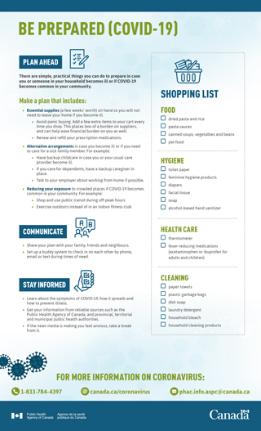
Canada's health system is ready to respond to cases that arise in Canada, but it is important that individuals and communities are ready if there is widespread illness here at home.
PHAC (March 7, 2020). Be prepared (COVID-19) factsheet.
https://www.canada.ca/en/public-health/services/diseases/2019-novel-coronavirus-infection/awareness-resources.html

Slide 41
Plan ahead
Take time to consider what you will do if you or a family member becomes sick and needs care.
Think about:
What food and household supplies you need for you and your family
What medicines you need, including renewing and refilling prescriptions ahead of time
Discuss your plans with your family, friends and neighbours, and set up a system to check in on each other by phone, email or text during times of need.

Slide 42
Plan ahead (con’t)
Fill your Prescriptions
See you health care provider ahead of time to ensure you have enough of your prescriptions as well as refills.
Have Essentials on hand
To ensure you do not need to leave your home while you are sick or busy caring for an ill family member.
Gradually purchase the items you need, for example:
dried pasta and sauce
prepared canned soups
canned vegetables and beans
pet food
regular detergents
household bleach
soap and alcohol-based hand sanitizer
toilet paper/paper towels
facial tissue
feminine hygiene products
diapers (if you have children who use them)
household cleaning products
garbage bags(for containing soiled tissues and waste
Notes:
To do this, you can add a few extra items to your grocery cart every time you shop.

Slide 43
Stay healthy and limit the spread of illness
To protect against respiratory illness:
Wash your hands often and well.
Avoid touching your face, nose, or mouth.
Avoid close contact with people who are sick.
Practice social distancing.
Reduce your exposure to crowded places by shopping or using transit during non-peak hours.
Clean and disinfect surfaces that are frequently touched.
Stay at home and away from others if you are feeling ill. If you are not seriously ill, do not go to a physician’s office, a health care facility or a lab without consulting with Health Link 811 first.

Slide 44
Where can I find up-to-date information about COVID-19?
Information on COVID-19 changes quickly and is updated frequently. For the most up-to-date information, visit one of the following websites:
Alberta Health https://www.alberta.ca/coronavirus-info-for-albertans.aspx
Alberta Health Services https://www.albertahealthservices.ca/topics/Page16944.aspx
Pubic Health Agency of Canada
https://www.canada.ca/en/public-health/services/diseases/2019-novel-coronavirus-infection.html
World Health Organization https://www.who.int/emergencies/diseases/novel-coronavirus-2019
Follow Canada’s Chief Public Health Officer, Dr. Theresa Tam, on Twitter at @CPHO_Canada
Follow Alberta’s Chief Medical Officer of Health, Dr. Deena Hinshaw, on Twitter at @CMOH_Alberta

Slide 45
QUESTIONS?

