Slide 1
COVID-19 Infection Prevention and Control PPE for Healthcare Workers
APRIL 2020

Slide 2
Overview
COVID-19 Current Situation
Coronaviruses
COVID-19 Characteristics
Infection Prevention and Control
PPE Training

Slide 3
COVID-19 Current Situation
On December 31 2019, an outbreak of pneumonia associated with a new coronavirus (COVID-19) was reported in China.
The outbreak is believed to have began at a market for live poultry, wild animals and seafood in Wuhan, China.
China has shut down the Wuhan market, as well as domestic and international transportation links from Wuhan and other affected cities in an attempt to contain the spread of the virus.
Notes:
As of February 26th 2020, 81,191 cases of COVID-19 have been confirmed in ____ countries/jurisdictions outside of mainland China.
The majority of cases remain in mainland China with over 78,064 confirmed cases and 2,768 deaths overall.
Canada has had 11 confirmed cases (travelers from China).
An evolving situation, data changes rapidly.
If you look to the last slide I have included a link for a nice visual and daily count of Cornoavirus COVID-19 Global Cases created by John Hokins CSSE.

Slide 4
Current Situation Globally
Update
COVID-19 continues to be a rapidly evolving situation.
Cases continue to rise on all continents, except for Antarctica, and have been steadily rising in many countries.
The date of symptom onset of the first case of COVID-19 in Canada was January 15, 2020
The United States is now reporting the highest number of cases followed by Italy, Spain, China, and Germany.
1 475 976 confirmed cases reported
Canada = 18, 447
United States – 425,107
86, 979 deaths
Canada –427
United States– 14,262
The WHO updates these numbers daily in the Situation Reports.
Lately, cases have been increasing by over 1,000/day and deaths have been increasing by about 50/day.
WHO (2020). Coronavirus disease (COVID-19) outbreak https://www.who.int/emergencies/diseases/novel-coronavirus-2019

Slide 5
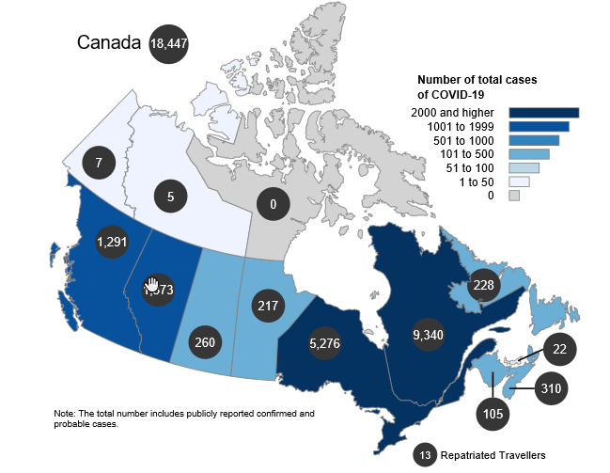
Current Situation Canada
Update
Canada - 18,447 as of April 8th, 2020
Aside from Canada, other countries and regions are reporting cases (listed below). An official global travel advisory is in effect: avoid non-essential travel outside Canada until further notice.
COVID-19 is a serious health threat, and the situation is evolving daily. The risk will vary between and within communities, but given the increasing number of cases in Canada, the risk to Canadians is considered high.
Interactive COVID-19 case map
https://www.canada.ca/en/public-health/services/diseases/2019-novel-coronavirus-infection.html#a1

Slide 6
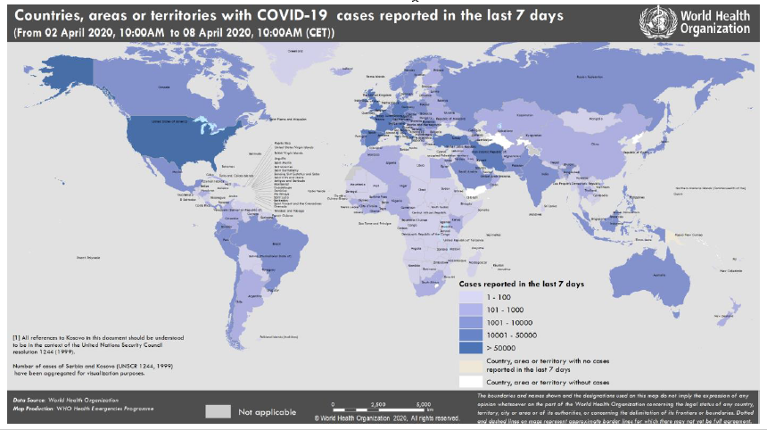

Slide 7
Etiology Human Coronaviruses
Human Coronaviruses
Enveloped
RNA viruses that are part of the Coronaviridae Family
7 are known to cause illness in humans
4 cause minor respiratory symptoms
Coronavirus 229E, NL63, OC43, or HKU1
2 cause life threatening disease
SARS CoV
MERS CoV
Cause respiratory illness in people
Mild common colds to severe pneumonias
Some spread easily between people, while others do not
Some cause no illness in people
Other Coronaviruses cause illness in animals only
Source: Centers for Disease Control (February 2020) Frequently Asked Questions and Answers
Notes:
Antivirals are also being investigated

Slide 8
COVID-19
COVID-19 is a novel coronavirus that has not previously been detected in humans before December 2019.
The official name for this disease is COVID-19
CO -“corona”, VI-“virus”, D-“disease” and the year it emerged 2019 = COVID-19
Source: Centers for Disease Control (February 2020) Frequently Asked Questions and Answers

Slide 9
Susceptibility
Underlying conditions of patients:
Outcomes as of February 3, 2020:
Susceptibility is assumed to be universal.
People with existing chronic medical conditions (e.g., cardiovascular and liver disorders, diabetes and other respiratory diseases) are likely more vulnerable to severe COVID-19 illness.
Source: Wang D, Bo Hu, et al. Clinical characteristics of 138 hospitalised patients with 2019 Novel Corona virus-infected pneumonia in Wuhan, China. The Lancet. 07.02.20 138 cases.

Slide 10
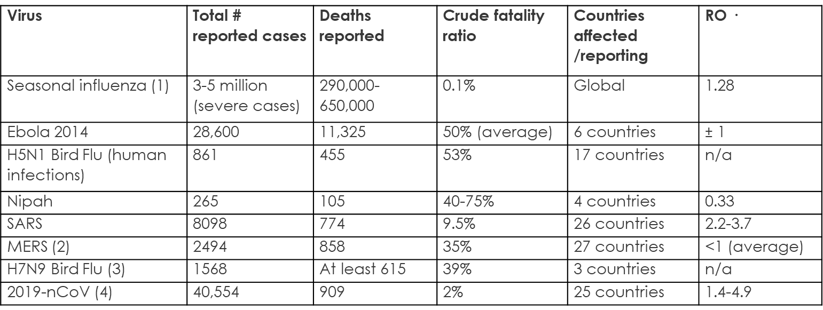
Characteristics of COVID-19 compared to other major viruses
World Health -ref

Slide 11
COVID-19: Mode of Transmission
The disease can spread from person to person through small droplets from the nose or mouth which are spread when a person with COVID-19 coughs or sneezes.
These droplets land on objects and surfaces around the person. Other people then catch COVID-19 by touching these objects or surfaces, then touching their eyes, nose or mouth.
People can also catch COVID-19 if they breathe in droplets from a person with COVID-19 who coughs out droplets.
Source: WHO (February 23, 2020). Q&A on coronaviruses (COVID-19) https://www.who.int/news-room/q-a-detail/q-a-coronaviruses

Slide 12
COVID-19: Mode of Transmission
It is possible that COVID-19 infected individuals could transmit the virus before significant symptoms develop
The highest risk of virus spread would be from a person who has symptoms like fever and cough. Human coronaviruses are rarely spread via fecal contamination.
Source: Alberta Health (February 2020). Notifiable Disease Management Guidelines – Coronavirus – Novel
WHO (February 20 2020). EPI WIN Powerpoint

Slide 13
COVID-19: Mode of Transmission
Person-to-person transmission
Occurring among close contacts including family members and healthcare workers
No evidence, to date, of airborne transmission
Although an aerosol-generating medical procedure (AGMP) has the potential to cause airborne transmission
Faecal-oral route: RNA has been detected in stool of infected patients but no live virus recovery has been achieved to date
Source: Alberta Health (February 2020). Notifiable Disease Management Guidelines – Coronavirus – Novel.
World Health Organization (February 20 2020). EPI WIN Power point.

Slide 14
COVID-19: Incubation period
Update
The lag time between infection and reporting confirmed case
Current estimates indicate a range from 0-14 days
Average estimates of infection and illness onset have been estimated at around 5 – 6 days.
Allowing for variability and recall error and to establish consistency with the WHO’s COVID-19 case definition, exposure history based on the prior 14 days is recommended at this time.
Source: Alberta Health (February 2020). Notifiable Disease Management Guidelines – Coronavirus - Novel
Cowling BJ, Leung GM. Epidemiological research priorities for public health control of the ongoing global novel coronavirus (2019 nCoV) outbreak. Euro Surveill 2020;26(6)

Slide 15
COVID-19: Clinical Presentation
Symptoms have range from mild to severe respiratory illness
Fever (>90% of cases)
Dry cough (80%)
Shortness of breath (20%)
Complications include:
severe pneumonia,
acute respiratory distress syndrome,
sepsis,
septic shock,
multi-organ failure
death
Source: Alberta Health (February 2020). Notifiable Disease Management Guidelines – Coronavirus - Novel

Slide 16
COVID-19: Treatment
There are no specific treatments for illnesses caused by human coronaviruses. Most people with COVID-19 will recover on their own.
No vaccine to protect against COVID-19
Symptoms are treated
Dehydrated -> I.V. fluids
Fever -> antipyretic
Difficulty breathing -> oxygen, intubate
The flu vaccine will not protect against coronaviruses
Source: Alberta Health (February 2020). Notifiable Disease Management Guidelines – Coronavirus - Novel

Slide 17
COVID-19 estimates on clinical severity (n=17185)
3%
critical
15% severe
82% mild
Source: World Health Organization (February 20 2020). EPI WIN Power point.

Slide 18
COVID-19: Exposure Criteria
Update
In the 14 days(D) before onset of illness, a person who:
Had any history of travel outside Canada;
OR
Had close contact with a confirmed or probable case of COVID-19;
OR
Is a close contact of a traveler with acute respiratory illness who returned from outside Canada in the previous 14 days;
OR
Laboratory exposure to biological material (e.g. primary clinical specimens, virus culture isolates) known to contain COVID-19.
Source: Alberta Health (February 2020). Notifiable Disease Management Guidelines – coronavirus –COVID-19
Notes:
* A close contact is defined as a person who provided care for the individual, including healthcare workers, family members or other caregivers, or who had other similar close physical contact with the person without consistent and appropriate use of personal protective equipment OR who lived with or otherwise had close prolonged contact (within 2 metres) with the person while they were infectious OR had direct contact with infectious bodily fluids of the person (e.g. was coughed or sneezed on) while not wearing recommended personal protective equipment.

Slide 19
COVID-19: Case definition
Update
CLINICAL ILLNESS
New onset/exacerbation of following symptoms:
fever (over 38 degrees Celsius)
and/or
new onset of (or exacerbation of chronic) cough,
shortness of breath (SOB)/difficulty breathing,
sore throat
runny nose

Slide 20
COVID-19: Case definition
Update
Confirmed Case
A person with laboratory confirmation of infection with the virus (SARS-CoV-2) that causes COVID-19 which consists of:
positive nucleic acid amplification tests (NAAT) on at least two specific genomic targets or a single positive target with nucleic acid sequencing at a Provincial Public Health Laboratory where NAAT tests have been validated(A)
OR
confirmed positive result by National Microbiology Lab (NML) by NAAT.
Alberta Health (March 2020). Notifiable Disease Management Guidelines – coronavirus –COVID-19
Notes:
Verify

Slide 21
COVID-19: Case definition
Update
PROBABLE CASE
A person with clinical illness who is a close contact to a lab-confirmed COVID-19 case;
OR
A person with clinical illness(B) who meets the COVID-19 exposure criteria;
AND
in whom laboratory diagnosis of COVID-19 is inconclusive.

Slide 22
COVID-19 : Case definition (cont’d)
Update
Persons with clinical illness and exposure criteria
A person with clinical illness
AND
who meets the exposure criteria.
NOTE: These individuals must be in isolation for a minimum of 10 days from onset of symptoms, or until symptoms have resolved, whichever is longer.
Alberta Health (March 2020). Notifiable Disease Management Guidelines – coronavirus –COVID-19

Slide 23
COVID-19: AHS/FNIHB Reporting Requirements
Update
The MOH (or designate) of the zone where the case currently resides shall notify the CMOH (or designate) of all probable and confirmed cases by the fastest means possible (FMP) (i.e. direct voice communication).
The MOH (or designate) of the zone where the case currently resides shall forward the Public Health Agency of Canada’s Novel Coronavirus (2019-nCoV) Case Report Form for all probable and confirmed cases to the CMOH (or designate) within 24 hours of initial FMP notification.
For out-of-province and out-of-country reports, relevant clinic information should be forwarded to the CMOH (or designate) by FMP (i.e. direct voice communication).
Alberta Health (February 2020). Notifiable Disease Management Guidelines – coronavirus –COVID-19

Slide 24
Actions: Government of Canada
Public Health Agency of Canada is monitoring the situation both on national and global fronts.
Border Health Services is screening at key airports that have direct flights from China.
Guidance Documents have been developed:
Infection Prevention and Control for novel Coronavirus (COVID-19):
Interim Guidance for Acute Healthcare Settings:
Interim National Case Definition: COVID-19
First Nations and Inuit Health Branch is working with Public Health Agency of Canada to update guidance, for example, remote isolated settings – containment
Vaccine development underway.
Notes:
Antivirals are also being investigated

Slide 25
Actions: First Nations and Inuit Health Branch
Communication to partners and regions is being streamlined through one email account to minimize duplication.
Indigenous Services Canada remains connected to the Public Health Agency of Canada’s federal/provincial/territorial communications on the domestic and international situations.
Personal protective equipment and infection control training has been conducted for health care providers in each region through a train-the-trainer approach. Regions are reaching out to communities and providing further training and information on infection prevention and control.
Regions are working with respective communities to update their pandemic annex of the All Hazards Emergency response plans.
Webinar sessions and other information sessions are being conducted by Regions and National Office to share information on the situation and infection prevention and control practices and public health measures.
Notes:
Communication (SitReps, Media Lines, etc.) to partners and regions is being streamlined through CDWG Secretariat.
ISC remains connected to the Public Health Agency of Canada’s FPT communications on the domestic and international situations.
PPE and infection control training is being conducted for health care providers in each of the regions, all are at different planning stages, through a train-the-trainer approach.
All Hazards Emergency Response plans.

Slide 26
On the horizon
Anticipate an increase in cases.
As the situation evolves, we all should take this opportunity to review our plans and processes as well as the routine infection prevention and control practices that help to limit the spread of infections.
Notes:
Containment focus currently: hence the self-isolation and reporting of symptoms to local PH offices

Slide 27
Reminder
We are still in the middle of influenza season in Canada;
a virus that causes 3000+ deaths in Canada each year.

Slide 28
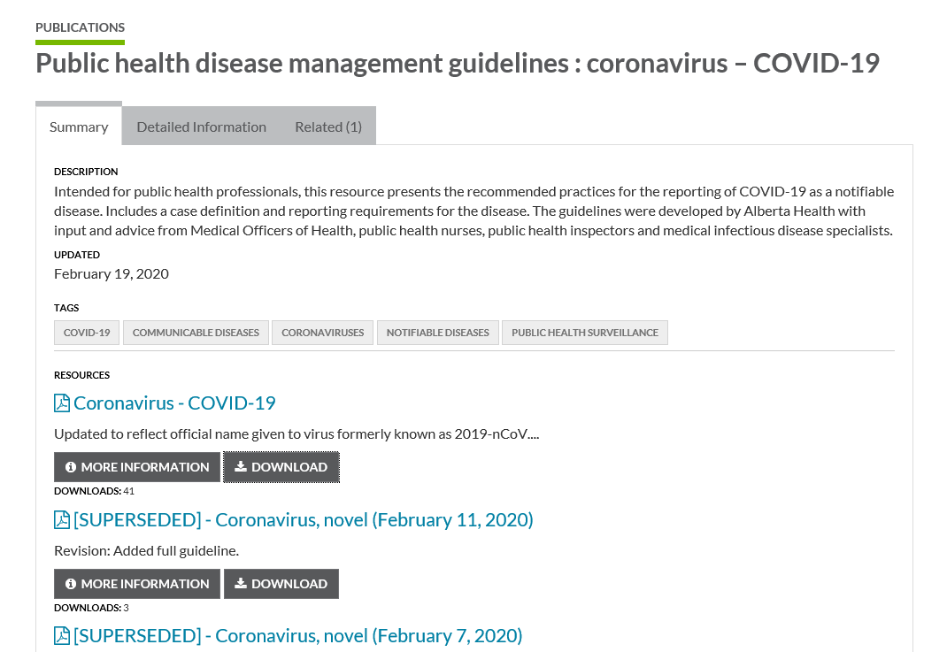
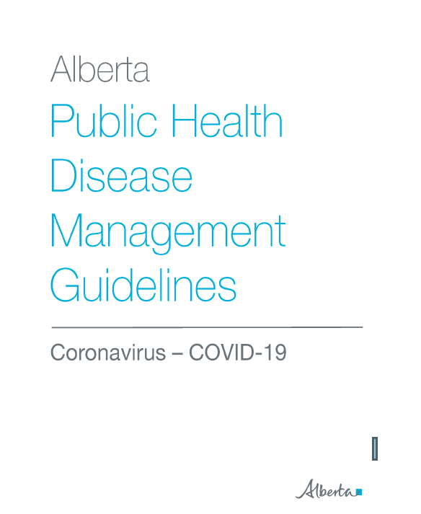
Resource: https://open.alberta.ca/publications/coronavirus-covid-19
Notes:
Public Health Disease management guidelines: coronavirus –CoVID-19

Slide 29
Infection Prevention and Control PPE for Healthcare Workers
March 2020

Slide 30
COVID-19 Chain of Infection
FNIHB Alberta (2017). Infection Control & Control Guidelines: Community Health
Notes:
So…What do we mean by transmission? Let’s look at this chain of infection starting at the infectious agent
What is causing the illness(bacteria, viruses or other),
How does it get to the next person ( thru water, food or from another person or animal)
How does it leave that person/animal ( thru blood or secretions or other)
What type of transmission( from touch, from air droplets or is it airborne – stays in the air for longer periods like TB)
How does it get into my body ( thru skin, breathing, etc)
What makes some people more likely to get sick.(immunosuppression, other diseases, recent surgery, age ( sometimes young sometimes older)
When the next person gets sick then the cycle starts again…

Slide 31
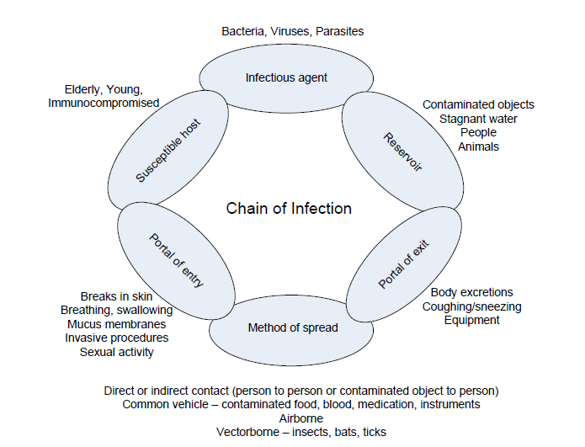
Causative/Infective Agent
A causative/infective agent includes:
bacteria
viruses
fungi and
parasites capable of causing disease.
The ability to cause disease is influenced by the organism’s specific characteristics: i.e. invasiveness, pathogenicity, virulence, infectious dose, viability in free state, host specificity, antigenic variation, its ability to develop resistance to antimicrobial agents.
FNIHB Alberta (2017). Infection Control & Control Guidelines: Community Health

Slide 32
Causative/Infective Agent
This link in the chain can be broken by eliminating or inactivating the agent. This is done by:
Hand hygiene
Environmental cleaning
Taking antibiotics as prescribed

Slide 33
Reservoir
A reservoir is where the organism lives, multiplies and includes humans, animals and the environment.
Human reservoirs may:
have active disease
be asymptomatic and/or in incubation period
be colonized with micro-organisms - temporarily or permanently – especially on skin and mucous membranes.
Transmission is increased where there are individuals who:
visibly soil the environment
cannot maintain appropriate hygiene (including respiratory hygiene)
are unable to understand or follow-through on instructions
have wounds or excretions which cannot be contained by dressings, diapers, etc.
FNIHB Alberta (2017). Infection Control & Control Guidelines: Community Health

Slide 34
Reservoir
Eliminate the reservoir by managing the environment:
Safe syringes
Clean and disinfect surfaces and equipment
Hand hygiene
Handle waste carefully

Slide 35
Portal of Exit
For an organism to be transmitted from one person to another, it must exit the body of the reservoir. Infectious agents are contained in blood, body fluids, excretions, secretions and skin.
They leave the human reservoir through:
Respiratory tract
Gastrointestinal tract
Skin/mucous membranes
FNIHB Alberta (2017). Infection Control & Control Guidelines: Community Health

Slide 36
Portal of Exit
Break this link by preventing the germs from leaving their environment
Practice respiratory etiquette
Contain bodily secretions
Dispose of waste and contaminated linen

Slide 37
Mode of Transmission/Spread
The mechanism of transfer of an infectious agent from a reservoir to a susceptible host is called the mode of transmission. The major modes include:
Contact
Indirect/Direct
Droplet
exposure of the mucus membranes of the conjunctiva, nose and mouth as a result of sneezing or coughing by an infected person
heavy and usually travel no more than approximately two metres (six feet) before falling to the ground
Airborne
dissemination of an infectious agent either by droplet nuclei or tiny particles suspended in the air for extended periods of time (hours)
Common Vehicle
contaminated inanimate vehicle such as food, water, or blood products
Vector-borne
Vectors (i.e. mosquitoes, flies and bats) carry microorganisms as part of their normal flora, or as an infection, and may infect humans through a bite
Some agents can be transmitted by more than one route.
FNIHB Alberta (2017). Infection Control & Control Guidelines: Community Health

Slide 38
Mode of Transmission/Spread

Slide 39
Mode of Transmission/Spread
This link can be broken by:
Hand hygiene
Environmental cleaning
Using PPE properly
Effective patient placement

Slide 40
Portal of Entry
These may be the same as the portals of exit. All of the portals have natural barriers that protect the body from microorganisms. The barriers are normally effective, but microorganisms may enter if the barriers are damaged, or if they have been compromised by invasive medical devices (e.g. catheters, feeding tubes).
Examples of portals of entry include:
Respiratory tract
Gastrointestinal tract
Urinary tract
Breaks in skin
Intrusive devices
FNIHB Alberta (2017). Infection Control & Control Guidelines: Community Health

Slide 41
Portal of Entry
We can prevent entry of germs by protecting skin and body openings.
Keep patients skin intact
Cover wounds
Use PPE

Slide 42
Susceptible Host
Humans have defense mechanisms to protect against infections. These include skin; mucous membranes; certain body secretions such as tears; inflammatory response; genetic, hormonal, nutritional and/or behavioural mechanisms; and personal hygiene.
Host characteristics that influence susceptibility to and severity of infection include:
Age
Gender
Ethnicity
Socioeconomic status
Marital status
Lifestyle
Nutritional status
Medications
Trauma
Natural antibodies
Disease history/underlying disease
Heredity
Occupation
Diagnostic/therapeutic procedures
Pregnancy
Balance in body’s normal flora

Slide 43
Susceptible Host
Best way to break the chain is to protect susceptible hosts by maximizing the person’s defenses:
Up to date immunizations
Maintain skin integrity
Proper nutrition
Identify high risk patients

Slide 44
Routine Practices
Routine practices is the term used by Public Health Agency of Canada to describe the system of infection prevention and control practices used to prevent the transmission of infections in health care settings.
They are to be used with all patients for all care and all interactions regardless of their diagnosis or infectious status.
Routine Practices protect both patients and staff from the risk of transmission of significant organisms
FNIHB Alberta (2017). Infection Control & Control Guidelines: Community Health

Slide 45
Routine Practices
Point of Care Risk Assessment (PCRA)
Hand Hygiene
Source Control
Client placement and accommodation
Personal Protective Equipment (PPE)
Sharps safety and prevention of bloodborne pathogen transmission
Management of the client care environment
Cleaning of the client care environment
Cleaning and disinfection of non-critical client care equipment
Handling of waste and linen
Education of Clients
FNIHB Alberta (2017). Infection Control & Control Guidelines: Community Health
Notes:
Pg 12 FNIHB Alberta (2017). Infection Control & Control Guidelines: Community Health

Slide 46
PCRA: Point of Care Risk Assessment
Performing a PCRA is the first step in Routine practices.
It is a method of assessment conducted by the caregiver that must be done at each interaction with the client or their environment to:
determine potential risks associated with providing care, as well as the
implementation of risk reduction strategies
interventions to minimize exposure to these hazards
It will help you decide what, if any, PPE you need to wear to protect yourself and to prevent the spread of germs.
ASSESS the TASK, the PATIENT and the ENVIRONMENT Prior to EACH PATIENT INTERACTION

Slide 47
PCRA: Point of Care Risk Assessment
1st think about your planned task: what will you touch? How will the patient or equipment in the space react to your actions.
2nd Note any possible contact you may have with blood or body fluids (e.g. coughing bleeding, runny nose, or soiled clothing, equipment or environment)
Environment = any area within 2 meters of the patient as well as their belongings and bathroom or the immediate space around a patient that may be touched by the patient AND may also be touched by the healthcare provider when providing care or performing tasks
BBF = Blood and Body Fluids (includes: urine, feces, wound drainage, saliva, vomit, CSF, sputum, nasal secretions, semen, vaginal

Slide 48
PCRA: Point of Care Risk Assessment
WHAT PROTECTION IS NEEDED?
Before you make contact with a client / client environment - ASK YOURSELF:
Are they coughing or sneezing?
Do they have a fever, rash or diarrhea?
Do I have the proper equipment?
Are there sharps containers and Alcohol-Based Hand Rub (ABHR) at point-of-care?
Could I come in contact with blood or body fluids?
Source: Indigenous Services Canada (February 2020). Routine Practices Webinar nCoV with situation update.

Slide 49
PCRA: Point of Care Risk Assessment
AHS PCRA: https://www.albertahealthservices.ca/assets/healthinfo/ipc/hi-ipc-acute-care-pcra.pdf

Slide 50
Hand Hygiene
Hand hygiene is most effective infection control measure to prevent the spread of infections and includes
Alcohol Based Hand Rubs (ABHR)
Handwashing (mechanical action or scrubbing with soap and water)
ABHR should be used as the standard practice for all HCWs with the following exceptions, when handwashing should be used:
when hands are visibly soiled with organic material, or
if exposure to norovirus and potential spore-forming pathogens such as Clostridium difficile is strongly suspected or proven, including outbreaks involving these organisms.
FNIHB Alberta (2017). Infection Control & Control Guidelines: Community Health
Notes:
Pg 13

Slide 51
Hand Hygiene
When hands are visibly soiled or where hand washing is indicated by PCRA, hand wash with soap and water:
A neutral soap from a disposable dispenser should be used for hand washing.
The routine use of antimicrobial soaps for hand hygiene is not necessary. However, antimicrobial soap with residual antimicrobial activity should be used for aseptic procedures.
Remove jewelry prior to washing. Fingernails should be kept short. Artificial nails and nail extenders are not acceptable in health care settings, as they are known to harbour infectious organisms
Wash all surfaces of the hands, in between fingers, knuckles and wrists for at least 15 seconds
Use single-use disposable paper hand towels to dry hands, not multi-use hand towels for drying
FNIHB Alberta (2017). Infection Control & Control Guidelines: Community Health
Notes:
Pg 43

Slide 52
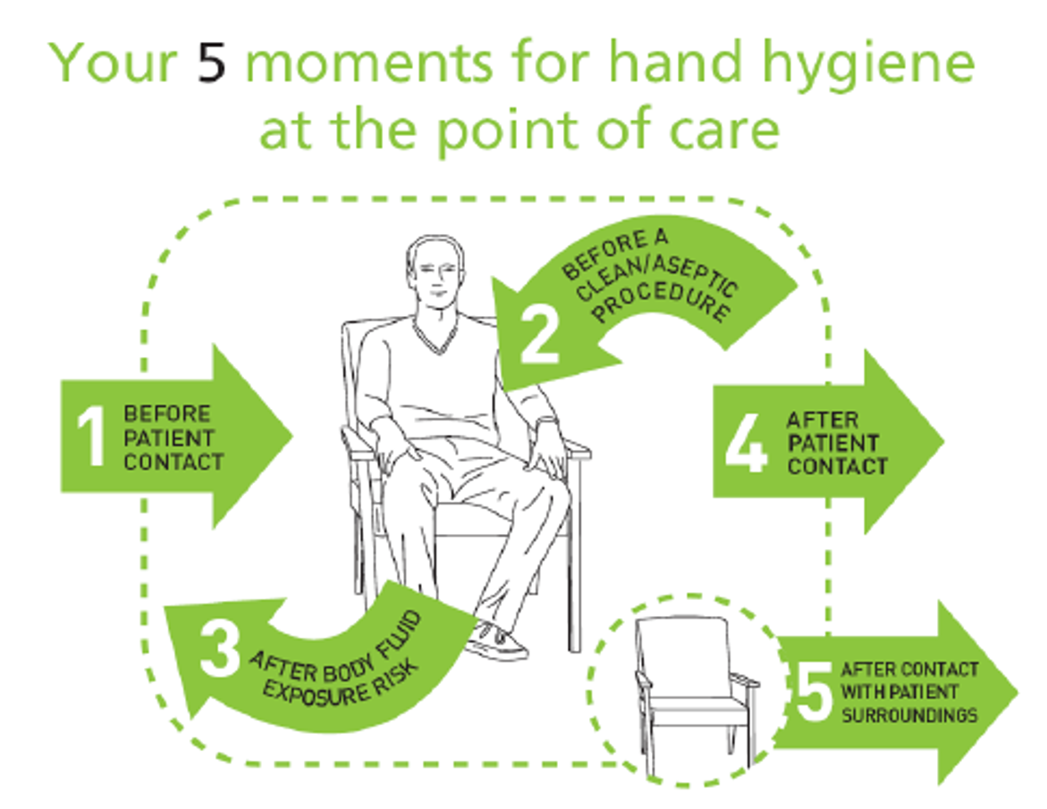
Hand Hygiene
Why we do hand hygiene:
To protect the patient against harmful germs carried on your hands
To protect the patient against harmful germs, including the patient’s own, from entering his/her body
To protect yourself and the healthcare environment from harmful patient germs
To protect yourself and the healthcare environment from harmful patient germs
To protect yourself and the healthcare environment from harmful patient germs
FNIHB Alberta (2017). Infection Control & Control Guidelines: Community Health, p. 47.

Slide 53
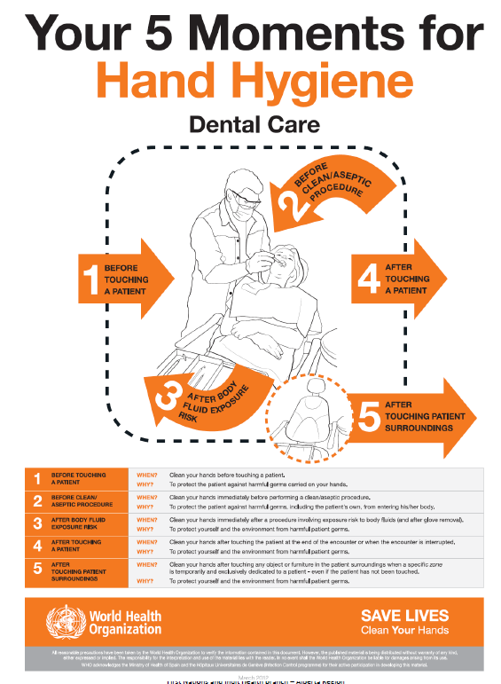
Hand Hygiene
Before touching the client
Before performing clean or aseptic procedures
After exposure to blood or body fluid and after glove removal
After touching the client
After touching the client surroundings
FNIHB Alberta (2017). Infection Control & Control Guidelines: Community Health
Notes:
Pg 13, 46
Five Moments Of Hand Hygiene
When providing care there are at minimum five moments of hand hygiene that can be applied in all heath settings for protecting the health care worker and the client from exposure to harmful bugs:
1. Before touching the client
2. Before performing clean or aseptic procedures
3. After exposure to blood or body fluid and after glove removal
4. After touching the client
5. After touching the client surroundings

Slide 54
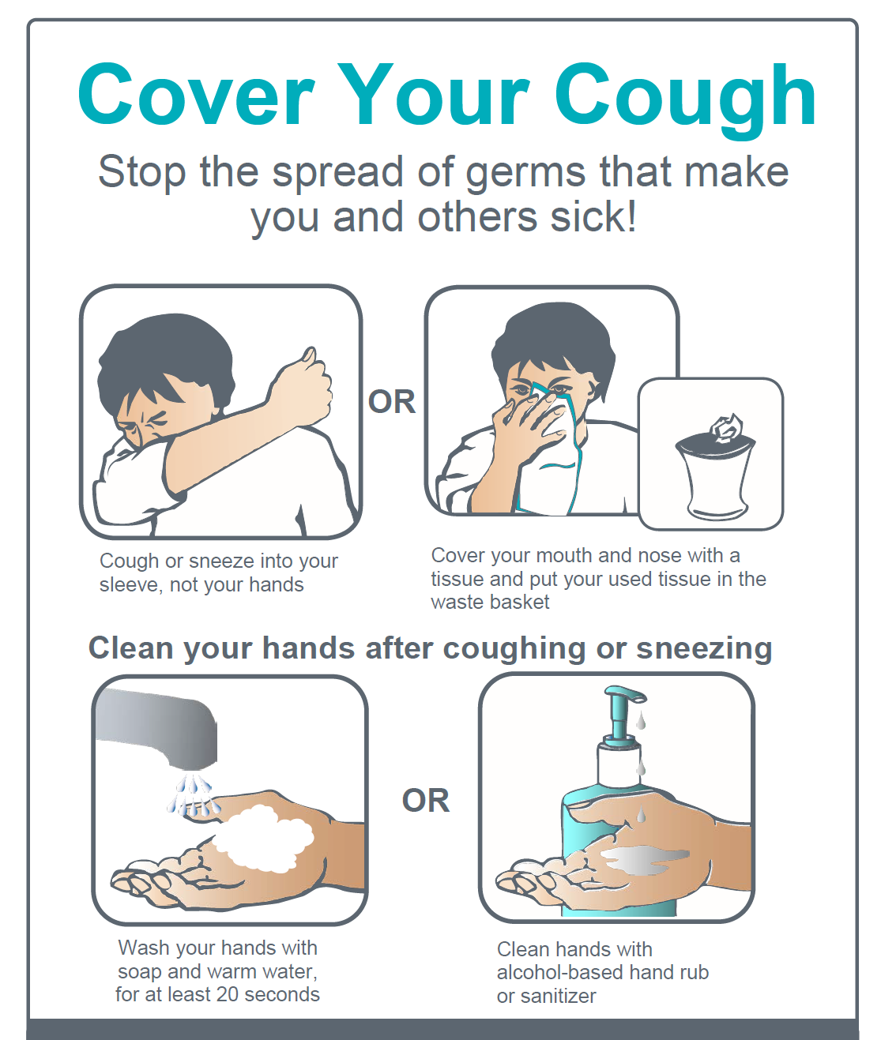
Source Control
Encourage handwashing for patients with respiratory symptoms
Provide masks for patients with respiratory symptoms
Patients with fever + cough or sneezing should be kept at least 1m away from other patients
Post visual aids reminding patients and visitors with respiratory symptoms to cover their cough
Consider having masks and tissues available for patients in all areas
Maintaining spatial separation of 2m between symptomatic patients
Adapted: PHAC (2013). Routine Practices and Additional Precautions for Preventing the Transmission of Infection in Healthcare Settings

Slide 55
Client Placement and Accommodation
Single room
Private bathroom
Isolation
Cohorting of clients
Cohorting of staff
Spatial separation
Barriers (door, curtain)

Slide 56
Management of Patient Environment
This includes:
environmental cleaning
handling of waste including sharps
Did you know…
There are more germs present on a keyboard or PC mouse than on a toilet seat
Our hands are responsible for the spread of 80% of common infectious disease
The average adult touches their face 18 times per hour!
Source: ISC (February 2020). FNIHB Communicable Disease emergencies Program: COVID-19 and Routine Practices Powerpoint

Slide 57
Environmental Cleaning
In 2016, each health centre received a USB stick with the training guide on it.
The complete training guide is now posted on OneHealth
Notes:
Remember the USB stick that were distributed to all regions in 2016? The Environmental Cleaning Training Guide is now located on 1 Health on the coronavirus page. Titles “ Then onwards to communities… now is the time to have another look at this resource

Slide 58
Environmental Cleaning
There is a section dedicated to COVID-19 on OneHealth.
The Environmental Cleaning Training Guide can be found in this section

Slide 59
Patient Care Equipment
Single use equipment should be used ONLY once, then discarded
Single use equipment is preferred, if reusable:
Multi-client reusable patient care equipment must be cleaned & disinfected daily and between patients
The disinfectant must have a DIN
Look for a broad spectrum disinfectant
Source: ISC (February 2020). FNIHB Communicable Disease emergencies Program: COVID-19 and Routine Practices Powerpoint
Notes:
The disinfectant product must have a DIN and virucide ( what works with influenza).
If pressed re Bleach…. Bleach is not an ideal product to use for day to day health facility cleaning… damaging to furniture/floor finishes; skin and lungs!

Slide 60
Administrative Controls
Policies, procedures, guidelines
Education for staff
Education for clients
Healthy workplace policies
Stay home if sick
Recommended immunizations.
Respiratory etiquette
Signage
Source: Public Health Ontario (November 2012). Routine Practices and Additional Precautions In All Health Care Settings, 3rd edition

Slide 61
Personal Protective Equipment (PPE)
PPE provide barriers or protection from hazards
Choose PPE that fits and is appropriate
Disposable PPE includes:
gloves (fluid resistant barrier to keep hands from becoming soiled)
masks (blocks splashes and sprays until it is saturated. Change when wet)
face shields/goggles (fluid impermeable barrier blocks splashes and sprays to eyes. Note: eye glasses are not a substitute for eye protection)
Gowns (fluid resistant barrier stops most splashes or sprays)
Source: ISC (February 2020). FNIHB Communicable Disease emergencies Program: COVID-19 and Routine Practices Powerpoint

Slide 62
COVID-19 Additional Precautions
Staff involved in patient assessment and transport should immediately initiate their own PPE.
ASAP– place patient in a single room and implement Contact & Droplet precautions
A single room with hard walls, a door and dedicated toilet or commode.
Signage should be visible on entry to room
Notify FNIHB CDC and MOH immediately.

Slide 63
COVID-19 Additional Precautions
Contact & Droplet Precautions
Required PPE
Gown
Gloves (sterile/non-sterile depending on procedure)
Facial Protection
Procedure mask
Eye protection - Goggles, face shield, or visor
NOTE: N95 use only for *Aerosol Generating Procedures
Intubation, CPR, Sputum induction, BiPaP
Does not include:
collecting naspharyngeal (NP) swabs
chest physiotherapy
*AGMP Procedures: Look at the “Additional Information” Slide at the end of the presentation
PHAC (February 2020). Coronavirus disease (COVID-19): For health professionals

Slide 64
PPE Matters
Memegenerator.net
Notes:
You never know what is next
PPE protects you
Prevents the spread od infections

Slide 65
Donning/Doffing PPE for Contact & Droplet Precautions

Slide 66
Donning PPE
Preparation
Pull hair back, secure off neck and face
Prevents you from touching your face while brushing hair out of your way.
Remove all extra items on person
Cell phones
Lanyards
Plan ahead and gather all PPE along with the rest of the supplies for a procedure or task.
Alberta Health Services (January 2020). Personal Protective Equipment and You (Learning Module)

Slide 67
Donning PPE
***Always perform hand hygiene prior to accessing PPE
Adapted from AHS (2014). Putting on (Donning) Personal Protective Equipment (PPE)

Slide 68
Donning PPE
A gown is the first piece of PPE you should don.
Your gown will protect your clothing and forearms from contamination by germs that may cause illness.
We will be using single use gowns, therefore they MUST be discarded into the garbage can.
NOTE: you cannot reuse a gown. It must be removed before caring for the next patient.
Adapted from AHS (2014). Putting on (Donning) Personal Protective Equipment (PPE)

Slide 69
Gown
If left untied the gown may unexpectedly open and your clothing could become contaminated.
When fully tied, the gown should stay out of your way and not need adjusting while you use it.
Pulling your gown over your head risks contaminating your eyes, nose, and mouth.
Need to change gown after each client encounter. Don’t want to spread the germs. Need to re assess if next encounter does need a gown or other PPE.
Used during client care activities likely to generate splashes or sprays of blood, body fluids, secretions, or excretions like urine or faces
Worn to protect clothing and arms from contamination (contact, splashes, sprays etc) of blood or body fluids

Slide 70
Gown
Gowns should:
Fully cover your body (down to the knees)
Fit comfortably over the body
Tie at the back
Have long sleeves that fit snugly at the wrists
REMEMBER:Do NOT reuse disposable gowns.

Slide 71
Donning PPE
Always don the procedure mask first before donning eye protection.
The mask will protect your nose and mouth from splashes and sprays of blood and body fluids.
It is also used for respiratory etiquette to contain droplets from symptomatic patients
NOTE: Always change your mask when it becomes moist
Adapted from AHS (2014). Putting on (Donning) Personal Protective Equipment (PPE)

Slide 72
Donning PPE
Eye protection can be reusable or single use. Ensure you know what type you have in your facility.
Reusable eye protection must be cleaned and disinfected after completing the required task
It will protect your eyes from potential splashes and spays
Regular eye glasses are not considered appropriate eye protection.
Source: Alberta Health Services (January 2020). Personal Protective Equipment and You (Learning Module)

Slide 73
Donning PPE
Gloves are NEVER to be reused.
Alcohol based Hand Rub is not approved for use on gloves
Remember to pull the cuffs of the gloves over the cuffs of your gown.
Exposed skin is unprotected skin
Source: Alberta Health Services (January 2020). Personal Protective Equipment and You (Learning Module)

Slide 74
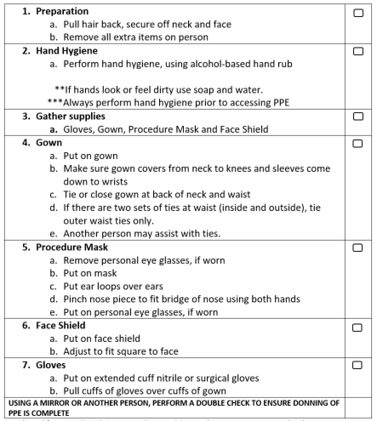
Donning Checklist Contact & Droplet Precautions
Adapted from AHS (2014). Putting on (Donning) Personal Protective Equipment (PPE)

Slide 75
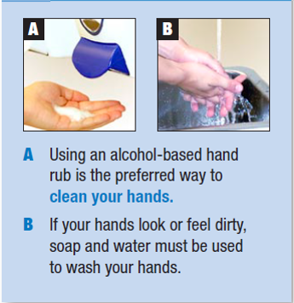
Doffing PPE
Gloves are the most heavily contaminated PPE items.
Always remove first to avoid contaminating your other PPE.
Always clean your hands as soon as you remove your gloves
Source: Alberta Health Services (January 2020). Personal Protective Equipment and You (Learning Module)
Notes:
Gloves may have natural holes in them and hands may become contaminated during use or when doffing your gloves. To prevent the transmission of germs, clean your hands after doffing your gloves.

Slide 76
Doffing PPE
Examine your gown for any visible signs of soil before taking it off.
Adapted from AHS (2014). Taking Off (Doffing) Personal Protective Equipment (PPE)

Slide 77
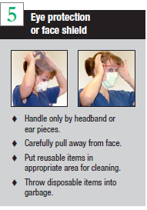
Doffing PPE
Adapted from AHS (2014). Taking Off (Doffing) Personal Protective Equipment (PPE)
Notes:
If eye protection is removed correctly you do not need to perform hand hygiene.

Slide 78
Doffing PPE
Adapted from AHS (2014). Taking Off (Doffing) Personal Protective Equipment (PPE)

Slide 79
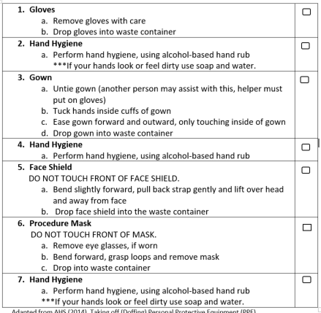
Doffing Checklist Contact & Droplet Precautions
Adapted from AHS (2014). Taking Off (Doffing) Personal Protective Equipment (PPE)

Slide 80
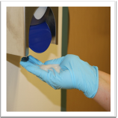
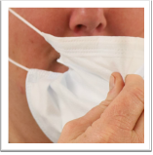
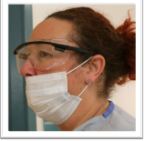
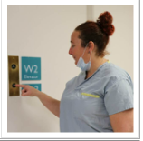
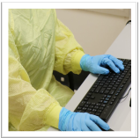
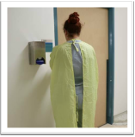
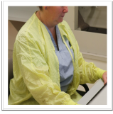
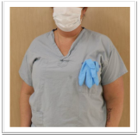
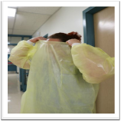
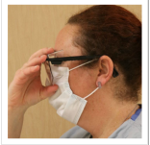
Common PPE Mistakes – What’s wrong with these pictures?
Alberta Health Services (January 2020). Personal Protective Equipment and You (Learning Module)
Notes:
Right to Left
Using ABHR on gloves
Gloves not over gown
Removal of mask by touching the front
Mask not covering nose
Mask on chin
Not removing PPE following use
Gown not tied at waist
Gown worn backwards
Gloves in pocket
Removing PPE over head
Using gloves to remove eye protection
Removing eye protection by touching potentially contaminated area

Slide 81
PPE Points to Remember
PPE should be stored appropriately
PPE must remain clean and dry
Store it with other clean supplies
Isolation cart
Utility room
Clean supply care
Only touch new PPE with clean hands
When stored at the point of care, it must be protected from contamination and must be discarded or cleaned if soiled
Once you enter a patient’s care space consider any PPE you are wearing to be contaminated:
Don PPE just before entering the care space
Collect all supplies before entering the care space
Doff PPE as soon as you are done using it; do not wear used PPE outside of the care space
Some PPE is task-specific: change gloves between tasks
Alberta Health Services (January 2020). Personal Protective Equipment and You (Learning Module)

Slide 82
PPE Skills Check
When you return to your centers:
Check
What glove size fits best
What gown size fits
Practice properly putting on (donning) and taking off (doffing) PPE with the “Buddy checklists”.
Try the AHS “PPE and You (Learning Module) 30-45 minutes (URL in Additional Information section)
Verify
Identify the PPE that you currently have in your facility
Verify that it is not expired
Order when required PPE

Slide 83
Ordering PPE
FNIHB Employed Nurses
Complete the Medical Supply/Pharmaceutical Order Form based on need and send to your Zone Nursing Manager.
Nation Employed Nurses
Utilize your normal acquisition pathways for PPE. i.e. medical supply distributor
NOTE: In a Pandemic Situation, FNIHB has access to a national stock piles of PPE which will be distributed to communities.

Slide 84
IPC Guidelines
Can be found on OneHealth under the CDC section.

Slide 85
Additional Information
AHS COVID-19 Information for HC professionals
PCRA
https://www.albertahealthservices.ca/assets/healthinfo/ipc/hi-ipc-acute-care-pcra.pdf
Real time COVID-19 Mapping
https://gisanddata.maps.arcgis.com/apps/opsdashboard/index.html#/bda7594740fd40299423467b48e9ecf6
AGMP Procedures
https://www.albertahealthservices.ca/assets/healthinfo/ipc/hi-ipc-respiratory-additional-precautions-assessment.pdf
AHS “PPE and You (Learning Module) 30-45 minutes
https://ahamms01.https.internapcdn.net/ahamms01/Content/AHS_Website/modules/ipc/ipc-ppe-and-you/story.html

Slide 86
PPE – return demonstration
Find a partner
Use the donning checklist
Don PPE for contact and droplet precautions
SMILE ☺ (group picture time)
Doff the PPE in the correct order
Watch to see if your partner contaminates themselves in any way

Slide 87
Questions?

