Slide 1
Overview of the Ontario Ministry of the Attorney General – Justice Canada Prosecution Pilot
ISC Special Chiefs Briefing
July 25, 2024
Justice Canada

Slide 2
Collaborative Table
In May 2021, the Collaborative Technical Table on the Enforcement and Prosecution of First Nation Laws (“Collaborative Table”) was established.
The purpose of the Collaborative Table is to explore solutions to challenges associated with the enforcement and prosecution of First Nations laws and by-laws in First Nations communities in Ontario.
The table is co-Chaired by officials from the Ontario Ministry of the Attorney General, Justice Canada, and Chiefs of Ontario.
Other participants include:
First Nations Working Group – includes representation from NAN, GCT#3, AIAI, Anishinabek Nation, Mushkegowuk Council Independent First Nations, Independent First Nations, Six Nations of the Grand River Territory (observer status) and Mohawk Council of Akwesasne (observer status)
Canada and Ontario - Ministry of Indigenous Affairs and First Nations Economic Reconciliation, Ministry of the Solicitor General, Indigenous Services Canada, Department of Public Safety and Emergency Preparedness
Observers - First Nations Land Management Resource Centre, Indigenous Police Chiefs of Ontario, Ontario Provincial Police

Slide 3
Prosecution Pilot
In December 2022, the Ministry of the Attorney General and Justice Canada launched a Prosecution Pilot which aims to improve community safety, wellbeing, and access to justice for First Nations in Ontario by providing funding to interested First Nations to retain private counsel to support the prosecution of First Nation laws.
To date, nearly 30 First Nation communities have expressed interest in the Pilot and 11 have applied and received funding.
These First Nations are at different stages of law development and enforcement and have used the Pilot funding to support prosecutions and to review and make changes to laws to improve the likelihood of enforcement and prosecution. Through the Pilot, participating First Nations have also established connections with other actors in the justice system (e.g., local courts and Crown Attorneys and local enforcement services) with the aim of working through operational and process issues in advance and as they arise in the Pilot context.
The Prosecution Pilot was recently extended to March 31, 2025. The extension will provide an opportunity for more First Nations communities to participate in the Pilot and will help to inform longer term solutions.

Slide 4
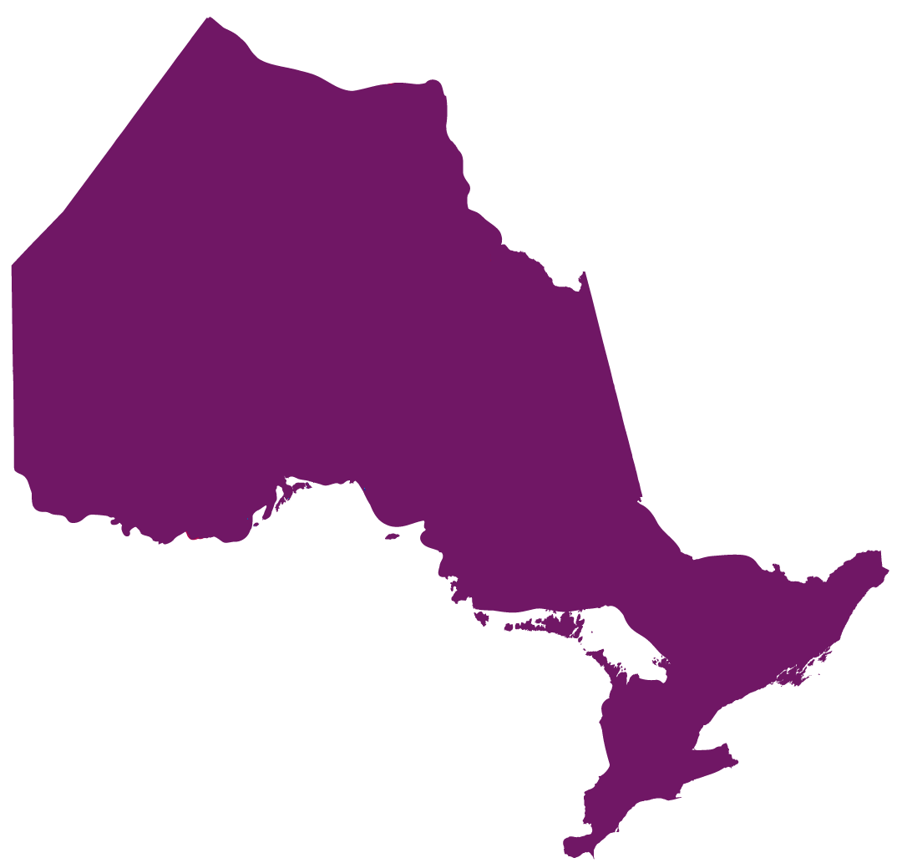
Current Participants in the Pilot
Aundeck-Omni Kaning
Chippewas of Georgina Island
M’Chigeeng
Mississauga
Mohawks of Akwesasne
Sagamok
Saugeen
Sheshegwaning
Whitefish River
Wiikwemkoong
Zhiibaahaasing

Slide 5
Extended Pilot – Applications Now Open
Open to all First Nations in Ontario that:
have one or more duly enacted First Nation laws. These laws may be enacted pursuant to jurisdiction recognized in federal statute (e.g., Indian Act by-laws, land Code laws), and/or pursuant to the First Nation’s inherent jurisdiction;
are seeking to undertake a legal review of those laws to support enforceability; and/or
are seeking to prosecute offences under those laws at the Ontario Court of Justice by way of summary conviction procedure or divert/refer matters to a community/restorative justice process.

Slide 6
Extended Pilot – Applications Now Open, con’t
Individual First Nations in Ontario are eligible to apply for funding as well as First Nation organizations applying on behalf of one or more First Nations in Ontario (i.e. Tribal Councils, Provincial-Territorial Organizations). An organization applying on behalf of one or more First Nations must provide a Band Council Resolution in support of the application from each community represented on the application.
Successful applicants are eligible to receive up to $35,000 per First Nation funded jointly by Canada and Ontario.
Applications will be accepted until December 31, 2024.
NOTE: The provision of funding under the Prosecution Pilot is not an acknowledgement by the Government of Ontario of the validity or enforceability of any First Nation law or recognition of an inherent law, inherent right or an Aboriginal or treaty right pursuant to s. 35 of the Constitution Act, 1982. For greater certainty, the Government of Ontario respects the authority of the Ontario Court of Justice to determine which matters it can adjudicate.

Slide 7
Thank you! Questions?
7

