Slide 1
Using and Downloading a TempTale Ultra
FNIHB – Alberta Region
December 2019

Slide 2
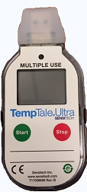
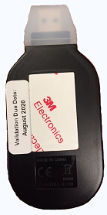
TempTale Ultra
Important Note:
The TempTale must already be configured before using or downloading it. See Configuring PowerPoint first if needed.

Slide 3
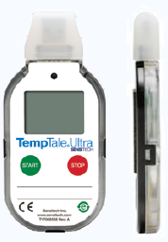
TempTale Ultra
Index
Slide 5 – 7: How to Start a TempTale
Slide 8 – 9: Where to use a TempTale
Slide 10 – 17: How to Use a TempTale
Slide 16: Verifying Temperatures
Slide 18 – 21: Alarm Status
Slide 22 – 24: Stopping a TempTale
Slide 25 – 32: Viewing Recorded Temperatures
Slide 26: Things to Check
Slide 33 – 39: Downloading Reports
Slide 40 – 41: Viewing Reports
Slide 42: Saving Reports
Slide 43 – 51: Clearing (Reconfiguring)
Slide 46: Troubleshooting
Slide 49: Suggested Settings

Slide 4
TempTale Ultra
Quick Summary
Slide 52: Specifications (FYI)
Slide 53: Display Information
Slide 54: Downloading Reports
Slide 55: Clearing (Reconfiguring)
Additional Information
Slide 57 – 59: Date Stamp
Slide 60: Christmas Settings
Questions?
Slide 56: Who to Contact

Slide 5
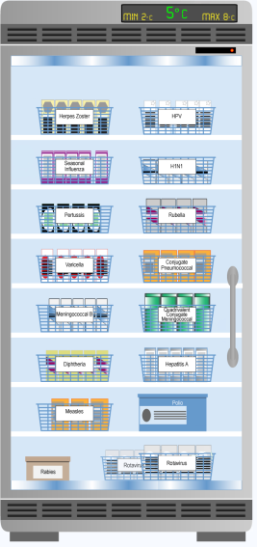
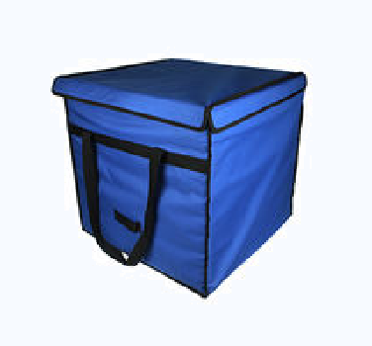
How to Start a TempTale
Before using a TempTale you must leave it in the fridge for about 15 minutes.
This allows the monitor time to adjust to the vaccine fridge temperature.
If turned on at room temperature it will trigger an alarm status.

Slide 6
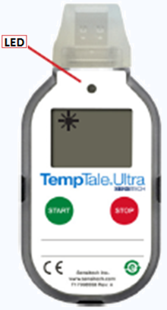
How to Start a TempTale
Press and hold the Start button for (1 – 3 seconds) until the Sunshine icon appears in the upper left corner of the LCD screen.
The will blink GREEN to indicate that the monitor has started recording.
It must be put in the vaccine fridge (or prepared vaccine bag) immediately.

Slide 7
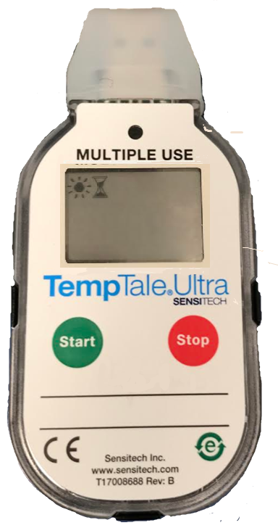
How to Start a TempTale
When a startup delay is programed during configuration, the delay icon will appear in the top left corner beside the sunshine .
The TempTale will begin recording once the set startup delay has ended.
The startup delay was set for 1 minute.

Slide 8
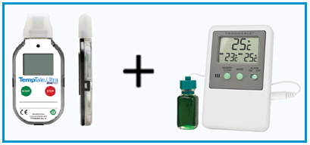
Where to use a TempTale
Vaccine Fridge
A TempTale is to be used in each vaccine fridge to monitor the temperature more precisely.
The TempTale is to be used in addition to the min/max thermometer. Min/max thermometer readings for vaccine fridges must continue to be documented twice per day.

Slide 9
Where to use a TempTale
Vaccine Bags
A TempTale should be used in vaccine bags when vaccines are being used or transferred.

Slide 10
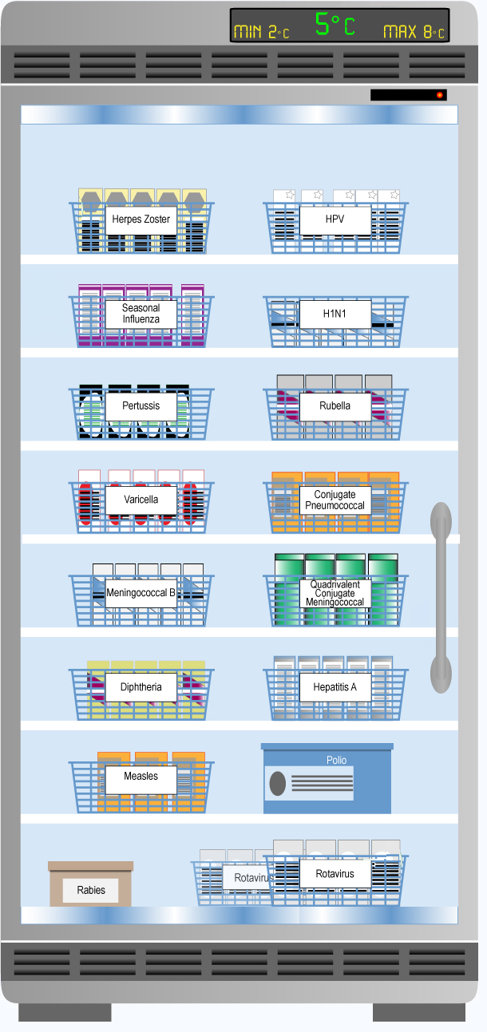
How to use a TempTale
Vaccine Fridge
Place the TempTale in the fridge. The LCD screen will still be blank.
Wait about 15 minutes for the TempTale to adjust to the fridge temperature.
(Continued on next slide)

Slide 11
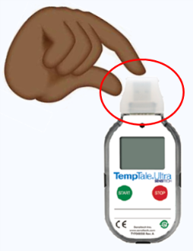
How to use a TempTale
Vaccine Fridge
Remove the TempTale from the fridge to turn on.
Hold the TempTale by rubber cap.
Start the TempTale. (Slide #5)
Place it back in the fridge to monitor the vaccine fridge temperature.
If the min/max thermometer shows a CCB, remove TempTale from fridge.
Press Stop and follow CCB procedures.

Slide 12
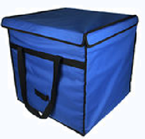
How to use a TempTale
Vaccine Bags
There are two options when using a TempTale to monitor vaccine bags:
Turn off the Temptale in between uses and store it in the vaccine fridge until needed again.
Useful if vaccine bags are only sporadically used.
Leave the TempTale on and store it in the vaccine fridge between uses until needed again.
Useful if vaccine bags are used several times during the week.
OR
(Continued on next slide)

Slide 13
How to use a TempTale
Vaccine Bags
If the Temptale is turned off and stored in the vaccine fridge until needed:
The TempTale must be downloaded and cleared after each use.
Start the TempTale only when you are ready to use it to monitor a prepared vaccine bag.
If the TempTale is left on and stored in the vaccine fridge between uses:
The TempTale will be need to be downloaded weekly.
Date stamp the TempTale each time it is moved from fridge-to-bag and visa versa.
Ensure transfers are immediate. Hold at the rubber cap.
OR
How to Date Stamp on Slide # 57.

Slide 14
How to use a TempTale
Vaccine Bags
Remove the TempTale from storage in the vaccine fridge.
Start the TempTale . OR
If the TempTale is already turned on during storage, press and release Start to Date Stamp.
Hold the TempTale by the rubber cap.
How to Date Stamp on slide # 57.

Slide 15
How to use a TempTale
Vaccine Bags
Immediately place the TempTale into the prepared vaccine bag.
Occasionally verify the temperature for Cold Chain Breaks.
When emptying the vaccine bag, follow option A or B. (Slide #17)
Hold the TempTale by the rubber cap.
How to Date Stamp on slide # 57.

Slide 16
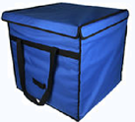
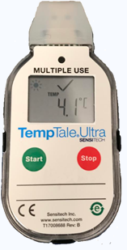
How to Use a TempTale
Verifying the Temperature
Open the vaccine bag and find the TempTale.
The TempTale will display a flashing sunshine in the top left hand corner, meaning the unit is recording the temperature.
The display will always show the last recorded temperature.
If there is a on the display, there has been no CCB.
If there is a on display, a CCB has occurred.
Replace the TempTale back into the bag.

Slide 17
How to use a TempTale
Vaccine Bag
When emptying the vaccine bag, remove the TempTale and either:
Stop the TempTale. (Slide #22)
Check Alarm Status. (Slide #19)
View Recorded Temperatures. (Slide #27)
Download Recording and Clear the TempTale. (Slide #35)
Store in the vaccine fridge until the next use.
Leave the TempTale running.
Hold the TempTale by the rubber cap.
Immediately Date Stamp. (Slide #57)
Quickly check the Alarm Status to make sure there was no cold chain break (Slide #19)
If there is a on the display, there has been no CCB. Return to the vaccine fridge immediately.
If there is a on the display, a CCB has occurred. Stop the TempTale and follow CCB procedures. (Slide #20)
Store in vaccine fridge until the next use.
OR

Slide 18
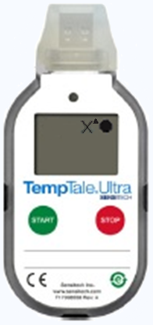
Alarm Status
What is it?
When the TempTale Ultra monitor is exposed to temperatures outside the programmed alarm limits (range of 2 – 8°C), an will appear at the top of the screen.
The icon will display if the high alarm was triggered. (display )
The icon will display if the low alarm was triggered. (display )
There is no sound, just a display image.
Alarm status

Slide 19
Alarm Status
Displays
= There are no alarm(s), cold chain maintained
= Temperature exceeded 8°C
= Temperature below 2°C
= TempTale stopped recording (manually)
= TempTale is still recording

Slide 20
Alarm Status
If a TempTale Indicates an Alarm Status:
The vaccines should be quarantined.
Ensure the product is placed in a cold chain fridge or vaccine bag as soon as possible. Follow cold chain break procedures.
Complete a “CCB Report.”
Wait for recommendations on the viability of the vaccine.

Slide 21
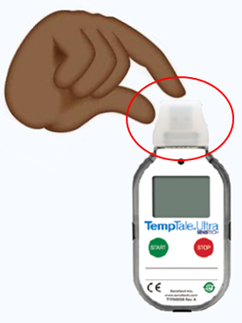
Alarm Status
False Alarm
The TempTale Ultra Monitor is very sensitive.
False alarms are possible, and may occur when:
Not stopped immediately after removal from the vaccine fridge or bag.
Held in hands too long. Suggestion: hold rubber cap.
Left at room temperature.
Turned on without first allowing device to adjust (about 15 mins) to temperatures inside vaccine fridge.

Slide 22
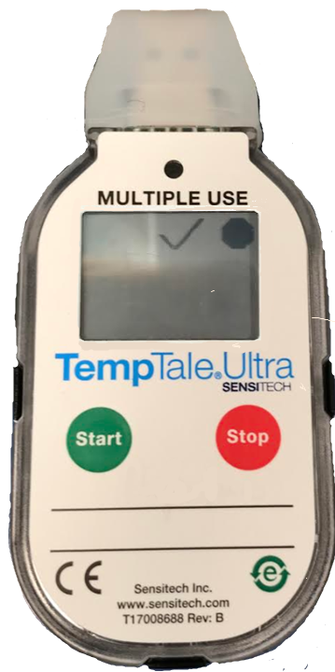
Stopping a TempTale
How To
To stop a TempTale:
Press and hold the red stop button (1 – 3 seconds) until the stop icon appears in the upper right corner of the screen.
The TempTale will display a stop icon to confirm it has stopped recording.
The sunshine icon will disappear.
The alarm status will remain on display ( or ).

Slide 23
Stopping a TempTale
When
The TempTale should be stopped when:
The TempTale and vaccines are removed from vaccine bags.
The TempTale is removed from the vaccine fridge for downloading.
Stopping the TempTale must be done immediately.
Not stopping the TempTale as soon as it is removed from cold chain may result in a false alarm.

Slide 24
Stopping a TempTale
Important Note
Once a TempTale has been stopped, it cannot resume recording until after data has been downloaded and cleared.

Slide 25
Viewing Recorded Temperatures
Viewing the average, high, and low temperatures
With the TempTale stopped:
Press the Start button to view the recorded temperatures.
The recorded data will appear in a series of five windows, cycling to the next reading each time you press the start button.
You can press the start button as many times as necessary to record all of the data.
If the temperatures were below 2°C or above 8°C, a Cold Chain Break (CCB) has occurred.

Slide 26
Viewing Recorded Temperatures
Things to Check
Is there a on the display, meaning the TempTale has stopped recording?
Is there a on the display, meaning there is no CCB? (Ideally, this will always display)
Is there a on the display, meaning a Cold Chain Break may have occurred?
Have the temperatures remained between the range of 2 – 8°C?
Verified when scrolling through. (See following slides)

Slide 27
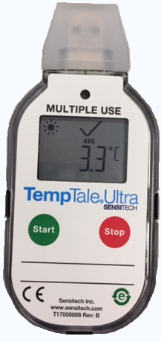
Viewing Recorded Temperatures
This is the order by which the recorded temperatures will be displayed when cycling through:
Average temperature.
Min. recorded temperature.
Max. recorded temperature.
Total time above high limit.
Total time below low limit.
The five windows will appear in the same sequence each time.

Slide 28
Viewing Recorded Temperatures
The first will show the average temperature during the monitoring cycle.

Slide 29
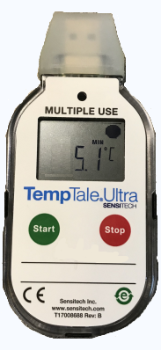
Viewing Recorded Temperatures
The second will show the min. temperature recorded during the monitoring cycle.
For example 5.1°C.
Note: If this is below 2°C, a Cold Chain Break has occurred. (See slide # 20)

Slide 30
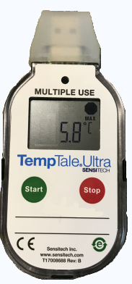
Viewing Recorded Temperatures
The third will show the max. temperature recorded during the monitoring cycle.
For example 5.8°C.
Note: If this is above 8°C, a Cold Chain Break has occurred. (See slide # 20)

Slide 31
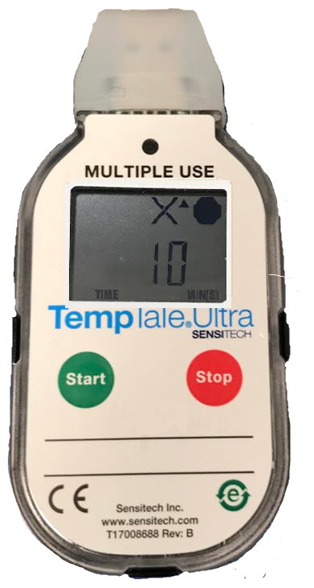
Viewing Recorded Temperatures
The fourth will show the total time above the high limit.
This is a cumulative total and may refer to more than one occurrence of a temperature at 8°C or higher.
For example, this monitor shows recorded temperatures of 8°C or higher for a total of 10 mins.
If the monitored temperatures remained within the 2 – 8°C range, the duration of the high temperatures will be 0.

Slide 32
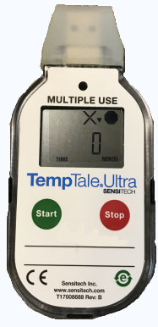
Viewing Recorded Temperatures
The fifth will show the total time below the low limit.
This is a cumulative total and may refer to more than one occurrence of a temperature at 2°C or lower.
For example, this monitor shows recorded temperatures of 2°C or lower for a total of 0 mins.
When the monitored temperatures remained within the 2 – 8°C range, the duration of the low temperatures will be 0.

Slide 33
Downloading Reports
Downloading and Clearing
Temperature recordings from the TempTale must be downloaded and cleared (reconfigured) weekly, or after each use, to free up storage space.
If the TempTale is not cleared, it will stop recording.

Slide 34
Downloading Reports
When should this be done?
Weekly for vaccine fridge TempTales.
To download data and free up storage space.
Anytime there is a CCB.
To review CCB details.
Every time the TempTale is stopped.
To download data and reconfigure.

Slide 35
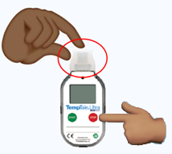
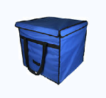
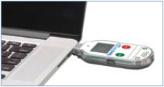
Downloading Reports
How to
Remove the TempTale from the vaccine fridge or bag and immediately stop the TempTale from recording.
Remove the rubber cap from the top and plug the TempTale into the computer USB port.

Slide 36
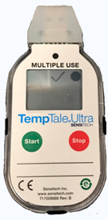
Downloading Reports
How to
The will blink RED while the Adobe®PDF report and TTV data file are being created.
Do not disconnect the TempTale from the USB port while the RED is blinking.
When the RED stops blinking and displays solid GREEN, the file generation process is complete.

Slide 37
Downloading Reports
How to
These files are now accessible.
Compatible with Windows®7, 8.1, and 10.
A window will automatically open on your computer. Depending on your computer, it will either be an Autoplay box, or open directly to a USB removable drive.
Note: No further purchases are ever necessary. If option appears, simply ignore it.

Slide 38
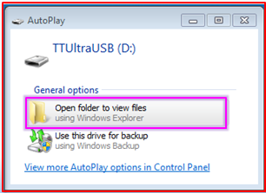
Downloading Reports
How to
If an Autoplay box appears, double click to “Open folder to view files.”
TempTale Ultra Monitor Reports and Data Files are now accessible on the removable drive.

Slide 39
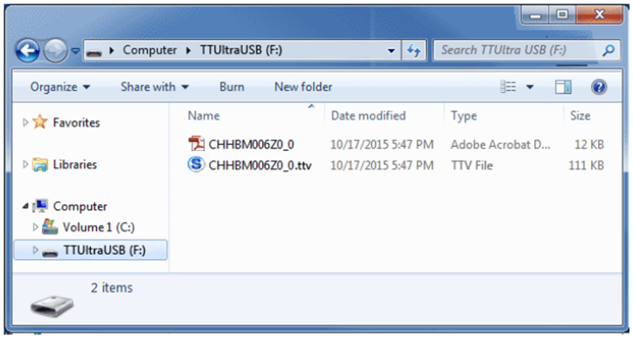
Downloading Reports
PDF file
TTV
Removable drive
See next slide.

Slide 40
Viewing Reports
How to
If the computer has Adobe®PDF compatible reader software installed:
Double-click the PDF file icon to open and view the PDF file. (Image on next slide)
If the computer has Sensitech’s TempTale Manager® Desktop Software installed (8.0 or higher):
Double-click the TTV file icon to open and view: monitor configuration information, summary statistics, and time-temperature data graph.

Slide 41
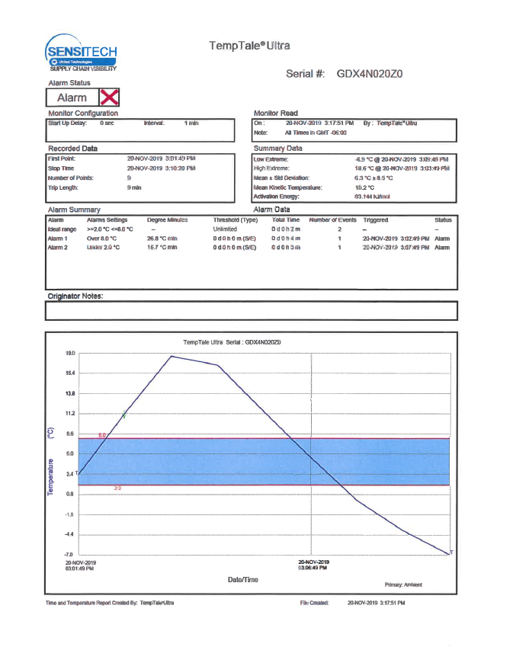
Viewing Reports
Example of PDF Reports
No CCB
CCB detected.

Slide 42
Save all Reports
According to Alberta Health’s: Alberta Vaccine Storage and Handling Policy for Provincially Funded Vaccines:
Cold chain monitoring reports must be saved for one year, regardless of CCB status. You may choose to:
Save the digital report(s) to a file on your computer.
OR
Save a paper copy of the report(s) by printing the PDF and placing it in a binder.
After one year you may delete or recycle the saved reports.

Slide 43
Clearing (Reconfiguring)
Ensure you have downloaded or saved data, as reconfiguring the TempTale will erase it!
TempTales must be reconfigured:
On a weekly basis for vaccine fridges.
Anytime a CCB occurs.
Anytime the monitor has been stopped.
Reconfiguring a TempTale monitor clears the recorded temperatures. If not cleared regularly, the monitor will become full and have no memory space for new recordings.

Slide 44
Clearing (Reconfiguring)
To clear (reconfigure) a TempTale, either:
Double click the TTV file icon on your computer desktop.
OR
Double click the TTV icon from the window that automatically appears when the TempTale is plugged in to the computer USB port.
This will open Sensitech’s TempTale Manager Desktop (TTMD) Software for reconfiguration.

Slide 45
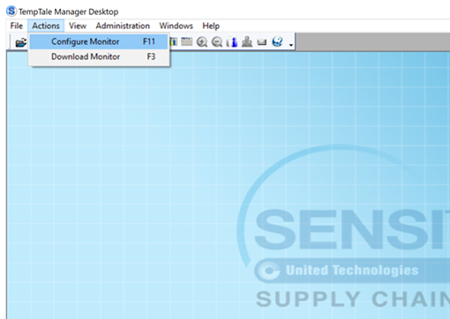
Clearing (Reconfiguring)
In the top left of the TTMD window:
Click “Actions.” Then from the dropdown menu,
Click “Configure Monitor.”
Has an error occurred? Ensure:
The TempTale has been stopped and is not still recording.
Is there an “open view”?

Slide 46
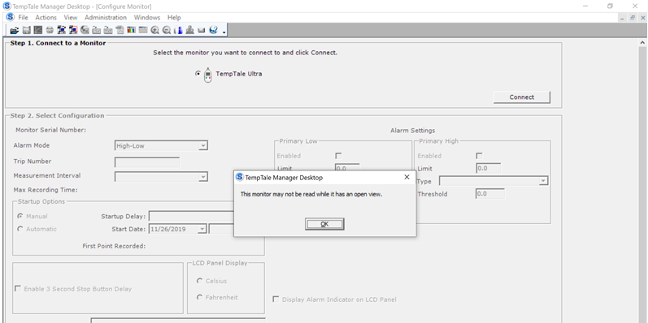
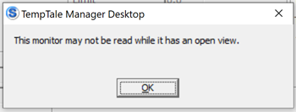
Troubleshooting
Do not click the top “x” until you are ready to exit out of the TTMD.
Note: If this window appears:
Click “OK,” then
Click the bottom “x” to close the background window and try again.

Slide 47
Clearing (Reconfiguring)
Connect to a TempTale.
Ensure you have downloaded or saved data.
Select the TempTale Ultra monitor.
Press “Connect.” The next section will appear.

Slide 48
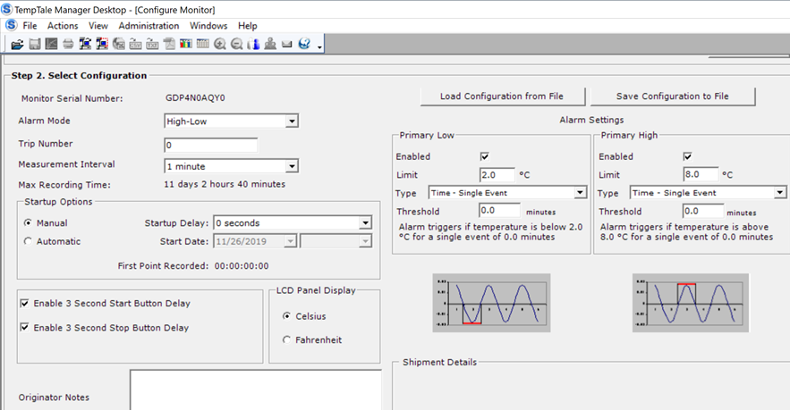
Clearing (Reconfiguring)
Select Configuration.
Verify the following (shouldn’t have to change):
Measurement Interval Time.
Startup Delay.
Low/High Alarm Settings.
See next slide for suggested settings.

Slide 49
Clearing (Reconfiguring)
Suggested settings:
Field | Suggested
Alarm Mode | High-Low
Trip Mode | 0
Measurement Interval | 1 minute
Startup delay | 1 minute
Enable 3 second start button delay | Enabled
LCD panel Display | Celsius
Set time zone and daylight savings option | Mountain Standard (GMT)
Alarm Settings - Primary Low | Enabled, Limit 2.0, Type: Time-Single Event, Threshold 0.0 Minutes
Alarm Settings - Primary High | Enabled, Limit 8.0, Type: Time-Single Event, Threshold 0.0 Minutes

Slide 50
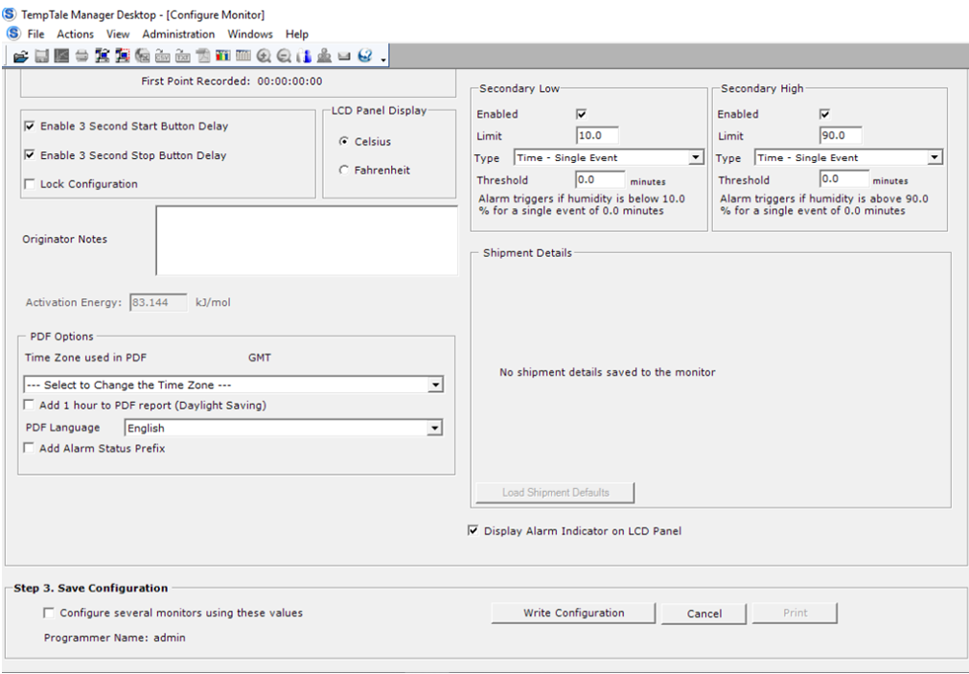
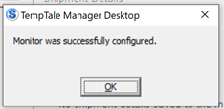
Clearing (Reconfiguring)
Save Configuration.
Click “Write Configuration.”
A TTMD box will appear, verifying the monitor was successfully configured.
Click “OK.”

Slide 51
Clearing (Reconfiguring)
Done!
Optional to print the settings.
The TempTale monitor’s LCD screen should now be blank and ready for next use.
You may close the window.
Store TempTale in the vaccine fridge.

Slide 52
FYI: TempTale Ultra Specifications

Slide 53
Summary
Display Information

Slide 54
Downloading Reports Summary
Make sure the TempTale is stopped.
Remove rubber cap and plug the TempTale into a computer.
Reports (PDF and datafile) will be created automatically.
GREEN indicates report generation is complete.
Reports are now accessible on a removable drive.
Save report.

Slide 55
Clearing (Reconfiguring) a TempTale Summary
Ensure you have downloaded or saved data, as reconfiguring will erase it!
Plug TempTale into the computer.
Open Sensitech’s TT Manager Desktop (TTMD) Software
Select Configuration.
Review: Intervals, Start Delay, Low and High Alarms.
Save Configuration.
Done. TempTale LCD screen will be blank and ready for next use. Store in the vaccine fridge.

Slide 56
TempTale Ultra
Please call Brent (780-495-8903) or Christina (780-495-5439) if you have any questions.

Slide 57
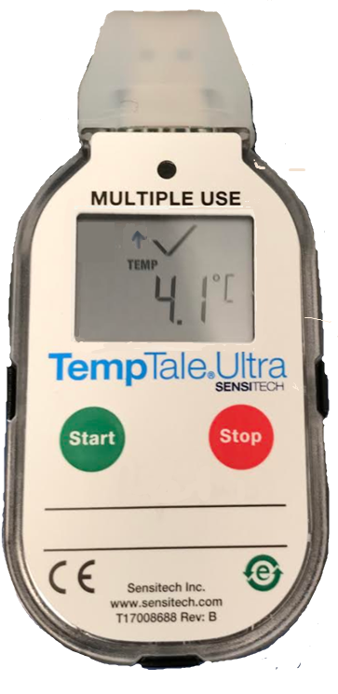
Additional Information
Marking an important Event (Date Stamp)
TempTale Ultra monitors provide an option to mark (Date Stamp) an important event at any time during the monitor recording period.
To mark an event while the monitor is recording, press and release the Start button .
An arrow icon will appear briefly in the top of the LCD screen and trip summary data will appear (slide # 27).

Slide 58
Additional Information
Marking an important Event (Date Stamp)
Date Stamps will be most important if your community chose the second option from slide #__ (to download TempTales weekly rather than each time it is transferred from vaccine fridge-to-bag and visa versa).
TempTales designated to vaccine bags will remain turned on during storage in the vaccine fridge.
Date stamps must be recorded each time the TempTale is transferred.

Slide 59
Additional Information
Marking an important Event (Date Stamp)
Date Stamps
This is how date stamps will appear when data is downloaded.

Slide 60
Additional Information
Christmas Settings
If the TempTale will not be downloaded weekly over the Christmas holidays:
Change the “Measurement Interval” to 3 mins on the last day the health centre is open. (Slide #48)
This will make sure the TempTale doesn’t run out of storage space.
More information can be found in the Configuring PowerPoint if needed. Letter [F]
Change the Measurement Interval back to 1 min after the Christmas break.
The min/max thermometer temperatures should still be documented for the vaccine fridge over Christmas.

